Slide 1
Tools Session

Slide 2
BA technical tools
Balasmiq
AxureRp
Microsoft visio

Slide 3
What are the roles and responsibities of a Business analyst
Gathering the requriements
Documenting the requriments
Modelling the requriments
Example: Modelling the requriments is into visualize the requriments into a visual format like mockups ,prototypes,UML’s ,images ,charts ...etc

Slide 4
Balsamiq
Balsamiq Studio is founded in March 2008 by Peldi Guilizzoni, a former Adobe senior software engineer.
Balsamiq is used to create web and mobile application user interface design tool for creating wireframes/mock-ups (drag and drop tool)
Wireframe is a raw visual representation of the website or app design.It is like a blueprint.
Wireframing helps the stakeholders to explain their requirements efficiently of the system.
A mockup design is an improved version of the wireframe and it shows how the future system will look like.

Slide 5
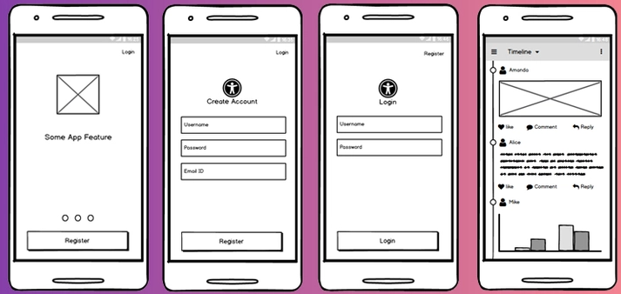
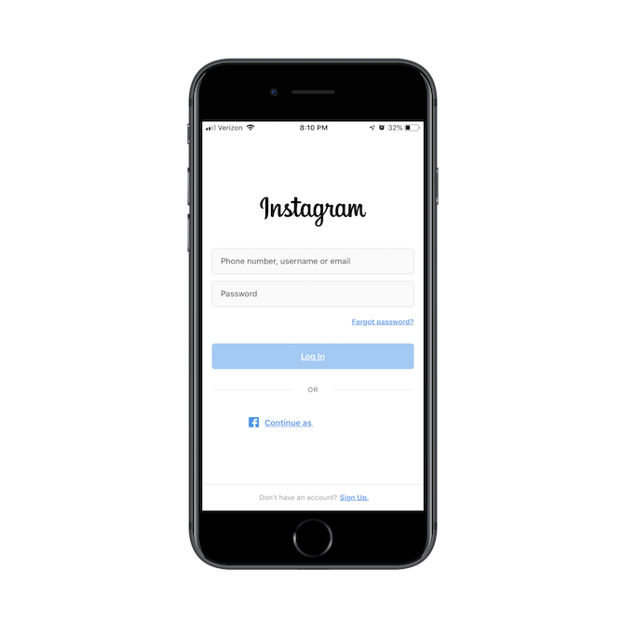

Slide 6
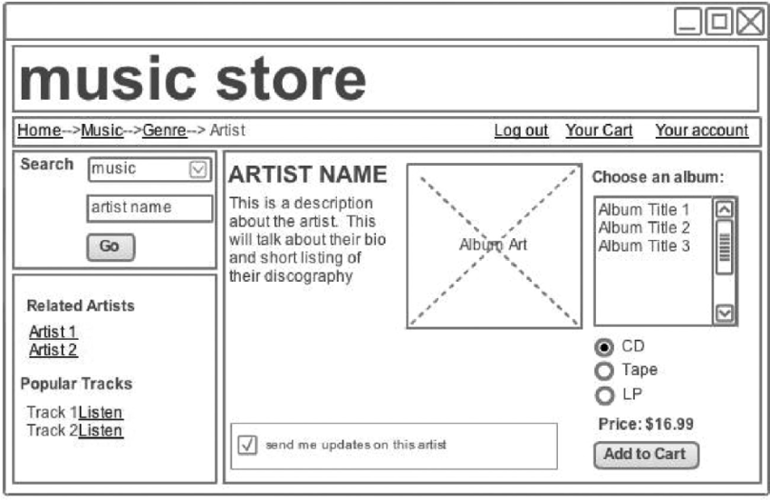
Reference wireframe image

Slide 7
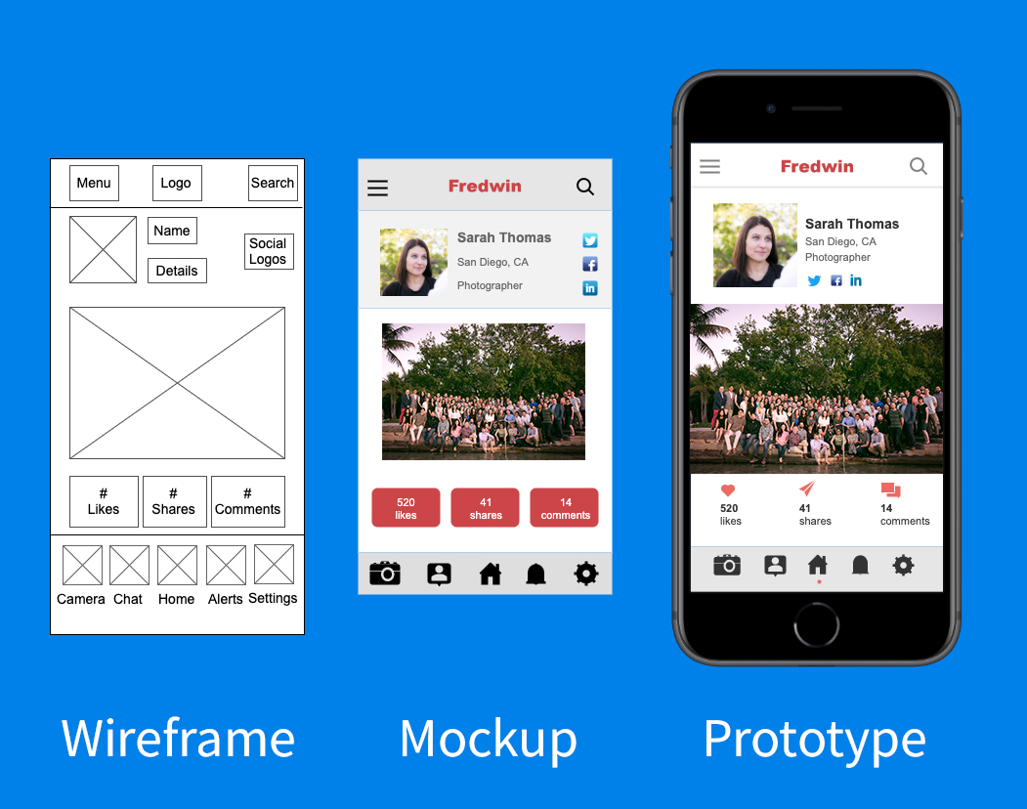

Slide 8
Difference between Wireframe ,Mockup and Prototype
Wireframe | Mockup | Prototype
A wireframe is a blueprint of the furture without any colour and functionality | A mockup design is an improved version of the wireframe and it shows how the future system will look like. | A prototype is a replica of the future system which is meant to simulate user interaction.
Wireframes can be designed on paper with a pen or pencil. | Mockup cannot be designed on the paper and you need to use mockup tools for the same. | The Prototype of a product is designed by the developer and business analyst to understand the sytem
A wireframe could be designed very quickly. | Mockup takes more time than wireframe but less than a prototype. | Prototype takes more time to develop.
It is designed by the business analysts. | It could be designed by the business analysts or UX design team. | It is developed by the development team and business analyst
It is developed in almost every project. | Mockups are also developed in all the projects. | Prototype may not be required for all the projects.

Slide 9
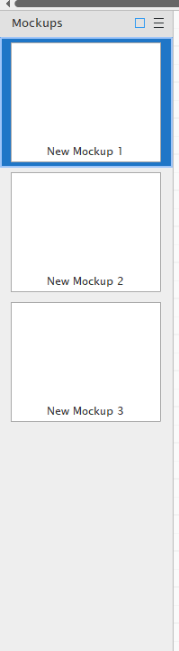
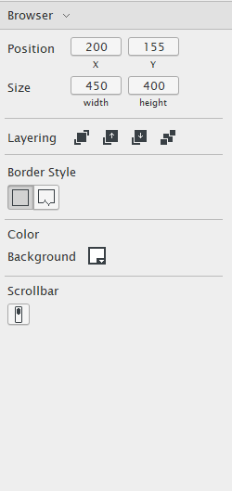
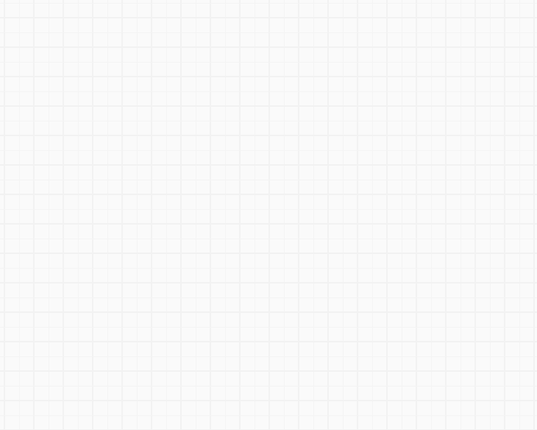
UI Library
Canvas
Property panel
Property Inspector

Slide 10
AxureRP [Rapid prototyping]
AxureRP is a powerful design tool for creating highly interactive prototypes for web, mobile, and desktop application with screen navigations. It has clickable buttons, input and output, and other
It allows the business stakeholders to get the feel of the future system and you can capture their feedback during the session.
The AxureRP is used at the starting of a project during both the Research and Design phases of a project.

Slide 11
TASK | AXURE | BALSAMIQ
COMPLEXITY | More advanced Requires more time to master | Less advanced Simpler tool to learn and use
Prototyping Capabilities | More powerful Advanced prototyping features | More focused on creating static wireframes and mockups.
Collaboration | Allows teams to work on the same project simultaneously, share design assets, manage changes and comments more efficiently. | Only one person can involve
Pricing | Subscription-based pricing model | More affordable-one-time fee
Output Formats | Supports a wider range of output formats, including HTML, CSS, and JavaScript | More focused on creating static images and exporting them in formats such as PNG and PDF

Slide 12
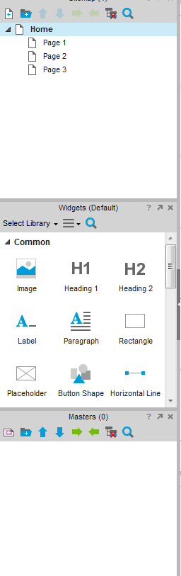
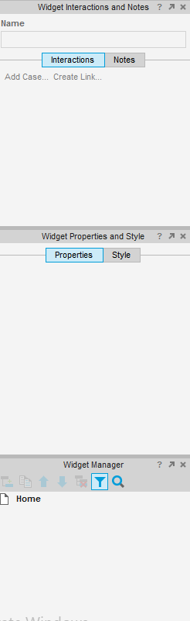
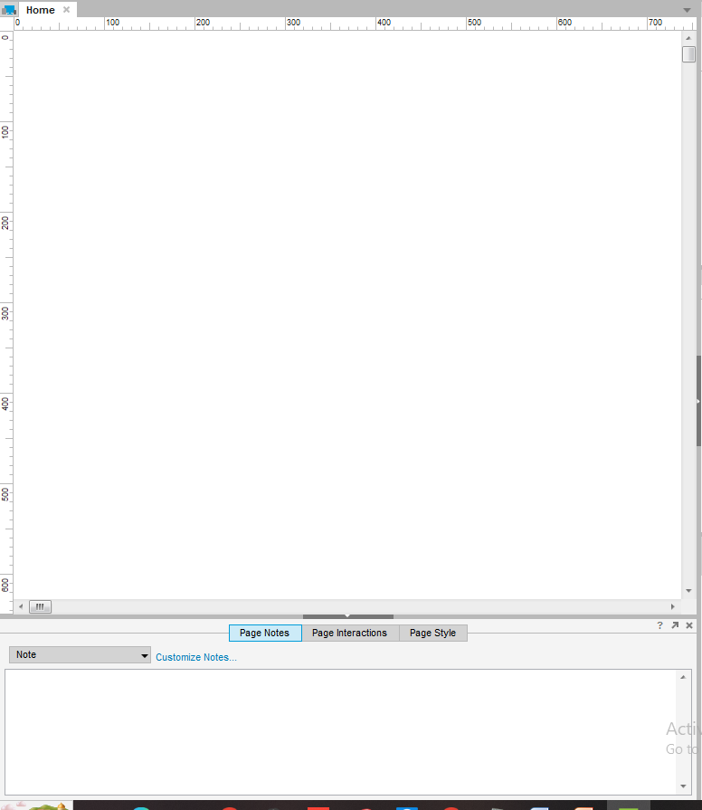
UI Library
Site map
Canvas
Interactions & Notes
Widgets

Slide 13
Microsoft Visio
Microsoft visio is a tool used to create UML - ( Unified Modeling Language) diagrams
UML has 9 diagrams
– 5 Static
– 4 Dynamic
There are two types of UML diagrams
5 static
4 Dynamic
• Use-case Sequence
• Class Activity
• Component State Chart
• Packages Collaboration
• Deployment
Sequence
Activity
State chart
collabration

Slide 14
Use-case diagram
1. Use case diagram ( User perspective)
2. Activity diagram ( System perspective)
3. Sequence diagram – Drawn by a developer but as a business analyst readability knowledge is good.
BA will prepare use case and activity diagrams

Slide 15
Use case diagram- A use case is used to represent the behavior of a system by incorporating use cases actors and relationships. A use case diagram is an actor specific.
ACTOR : The person who will interact with the system we called as actor.
Actors are classified into primary and secondary actors.
Primary actor –The primary actor will initiate the system .
Secondary actor– The secondary actors, on the other hand, are used by the system but they do not interact with the system on their own.[secondary actor will help primary actor]
USE CASE
Essential use case
Supporting use case
Use case is denoted by vowel shape
SYSTEM BOUNDARY
System boundary is separate the actors and system

Slide 16
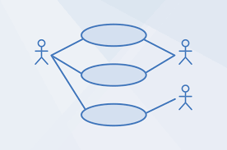
Relationships
Use-case diagram classified into three types of relationships
Include [Mandatory]
Extend [Optional may or may not be]
Generalization .Generalization is also known as inheritance relationship between parent class and child class .
Actor
Relationship lines
System

Slide 17
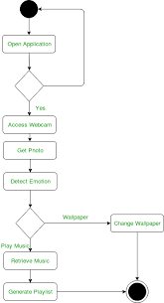
Activity diagram- Activity diagram is flow chart to represent the workflow
Start node- Started node represented with black circle
Action state/state- Action state are symbolized with round edged rectangles
Control flow- Connecting between one state to another state
Decision box – To take decision yes or no situations
Fork and join- Fork and join is a control node that splits flows into a multiple co-current outgoing edges
End node- End node represents final steps in the activity

Slide 18
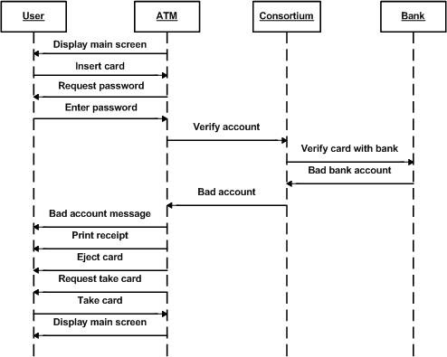
Sequence diagram
A sequence diagram is interaction between objects and other actors
These diagram are used by software developers and business professionals to understand requirement for a new system .
Sequence diagrams - MVC Guidelines, 3-tier architecture
Example:
ATM transaction
Reference diagram

Slide 19
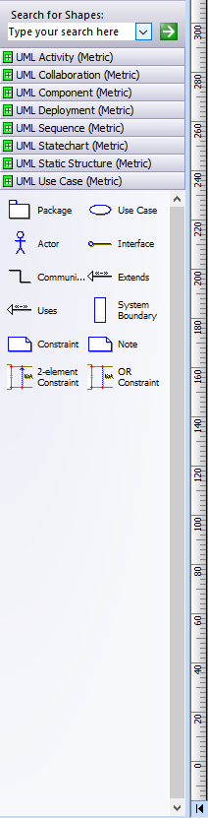
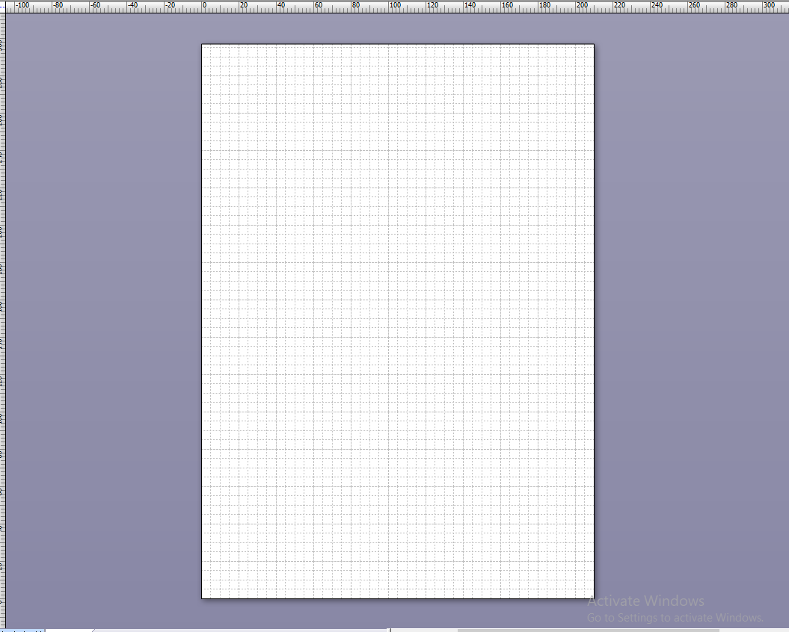
Features
Canvas
UML Components

