Slide 1
Finacle
Vishnu e
03.05.2025

Slide 2
Situation: Finacle is a digital banking solution suite offered by EdgeVerve Systems, a subsidiary of Infosys. It provides a comprehensive platform for financial institutions to manage their digital banking operations, including core banking, digital engagement, and cloud-based solutions. Finacle is used by banks in over 100 countries and serves over 848 million customers. Finacle was created in 1999 as a core banking software suite and has been a part of Infosys' subsidiary EdgeVerve Systems since 2015. Finacle is a accounting application were we generally perform multiple activities related to banking. 1. Viewing account statement. 2. Viewing account details with type of account, personal details, status of account, etc. 3. Viewing lability details of a client for a corporate account. 4. Processing funds transfer such as NEFT/ RTGS. 5. Processing other financial transactions related to clients request via this applicant. However the applicant does multiple activities, we have request from bank for enhancement of applicant in certain areas were we have scope of improvement and also with these changes client except their 20% of work life will be made easy.

Slide 3
Problem: As a application works very much fine, Finacle offers an open architecture and allows integration with other applications and platforms allowing delivery of innovative solutions. However still there is lot of scope for changes in the application with respect to different products team input from the banks point of view. When we got a real time situation from client for an enhancement in applicant from a product group called as trade finance and lending team, we had to check, analyze, work on the change/ enhancement request raised from client team. Some of changes requested were: 1. Cloning of an already processed transaction, for reducing TAT of processing a transaction with same details by changing only required fields. 2. Printing of advice letter for several products where transaction has been processed by central team and where we can provide client with the correct advice letters. 3. Processing of inward/ outward remittance via this applicant itself instead of using another application and linking the results with this application. 4. For trade financing products we need to check for client limits in current account and basis their credibility we can lend client, so for this as we already have option for viewing, however for blocking the limits also needs to be done from this application itself. 5. Viewing of all the booked liability under a client account for understating the used lability, in order if the liability has been already paid by client and to update in system also.

Slide 4
Opportunity: An advanced omnichannel solution that helps banks – onboard, sell, service and engage – retail, small business and corporate customers. Finacle Retail Banking Solution suite empower banks across 100 countries to achieve comprehensive insight, develop deeper connections, drive continuous innovation. Opportunities are positive risks that could lead to better-than-expected project outcomes. They are distinct from choices or facts, focusing on uncertainties that could lead to favorable results. As per listed problems in previous slide, by incorporating these change/ enhancement in the application: 1. Bank could mitigate the risk of data flow between 2 different application. 2. Reduce the work load on an individual. 3. Make the work life easy with no hustle. 4. Provides great support to team members and client as well. 5. Reduces turn around time in servicing client with at most care and priority. 6. And also, could provide banking individual with handling more transactions and providing a great service to clients.

Slide 5
Purpose Statement (Goals): The overarching goal of project management is to deliver a project successfully by effectively planning, organizing, and controlling resources to achieve the project's objectives. So, in our change/ enhancement request the major goal are: 1. Project Completion: Ensuring the project is completed successfully within the defined scope, time, and budget. 2. Meeting Objectives: Achieving all project objectives as defined by the stakeholders. 3. Optimizing Resources: Efficiently using allocated resources (time, budget, materials, etc.) to maximize project outcomes. 4. Managing Risks: Identifying, analyzing, and mitigating potential risks that could impact the project's success. 5. Stakeholder Management: Effectively managing stakeholder expectations and ensuring their needs are met throughout the project lifecycle. 6. Improving Productivity and Performance: Enhancing the overall efficiency and effectiveness of project execution. 7. Facilitating Communication and Collaboration: Ensuring clear and effective communication between team members and stakeholders. 8. Continuous Improvement: Identifying areas for improvement in project processes and implementing changes to enhance future project performance. 9. Delivering Value: Ensuring the project delivers the intended benefits and outcomes for the organization.

Slide 6
Project Objectives: In order for us to meet the goals of the project we need to keep in mind the key characteristics of project objectives: 1. Specific: Objectives should clearly define what is to be achieved, avoiding ambiguity. 2. Measurable: Objectives should be quantifiable, allowing for progress tracking and success assessment. 3. Attainable: Objectives should be realistic and achievable given available resources and time constraints. 4. Relevant: Objectives should align with the overall project goals and contribute to the broader organizational objectives. 5. Time-bound: Objectives should have a defined timeline, providing a sense of urgency and focus. So, keeping the above characteristics in mind we need to be objective and attain focus in project by following the below listed: 1. As the change/ enhancement request is received, we need to analyse the request and find the correct method for performing elicitation technique for requirement gathering process, so for this project we could use Focus group or Document analysis technique for requirement gathering. 2. Once all the requirement is gathered and analysed, we need to conclude for request changes are really required for betterment of users work or not. 3. Then once approval is taken then we need to provide necessary use case specs to design team and allow the development team to do the necessary changes in existing applicant codes using the correct coding language. 4. Once the design and development stage is done then we can allow the testing team perform necessary tests, so basis the correct testing we can go-ahead with UAT testing and when all results to positive outcomes then we can give the applicant for production team and take proper signoff for the project.

Slide 7
Success Criteria: Success criteria are the measurable standards used to determine if a goal or objective has been achieved. They should be specific, measurable, achievable, relevant, and time-bound (SMART). Essentially, they are the benchmarks against which success is evaluated. So, in order for us to success in this project we need to keep all the below points in minds: 1. Project Completion: Complete the project within the specified timeframe and budget. 2. Product Launch: Achieve a 20% increase in user engagement within the first month of the launch. 3. Customer Satisfaction: Increase customer satisfaction scores by 5 points within the next quarter. 4. Learning Outcome: All the team members need to be in continuous learning or updating them selves in their areas for new technologies and other things related to their field for coming with better and new solutions to a problem. We need to keep the major 3 constraints in mind that are cost, scope and time for any project to be success.

Slide 8
Methods/Approach: In this project for request for change/ enhancement in banking application, we will be using waterfall method for going ahead with process of the project. So, lets see the method and understand it by understanding each stage of the process. Requirements: We need to gather all the necessary information form all the stake holders, so we will be using Focus group or Document analysis technique for requirement gathering, which is best suitable for this project as the application is already available and we need to enhance some areas were there is scope of addition of a viable option. Design: Here, software developers design a technical solution to the problems set out by the product requirements, including scenarios, layouts, and data models. First, a higher-level or logical design is created that describes the purpose and scope of the project, the general traffic flow of each component, and the integration points. Once this is complete, it is transformed into a physical design using specific hardware and software technologies. Development: Once the design is complete, technical implementation starts. This might be the shortest phase of the Waterfall process because painstaking research and design have already been done. In this phase, programmers code applications based on project requirements and specifications, with some testing and implementation taking place as well. If significant changes are required during this stage, this may mean going back to the design phase. Verification or testing: Before a product can be released to customers, testing needs to be done to ensure the product has no errors and all of the requirements have been completed, ensuring a good user experience with the software. The testing team will turn to the design documents, personas, and user case scenarios supplied by the product manager to create their test cases. Deployment and maintenance: Once the software has been deployed in the market or released to customers, the maintenance phase begins. As defects are found and change requests come in from users, a team will be assigned to take care of updates and release new versions of the software.

Slide 9
Resources: Project management resources encompass any element needed to execute and complete a project, including people, equipment, materials, budget, time, and information. Effective management of these resources is crucial for successful project delivery. 1. People: Project team members, their skills, experience, and availability. 2. Equipment: Tools, machinery, strong broadband connection, java and other necessary applications, cloud storage and technology necessary for project execution. 3. Materials: Physical resources like raw materials, components, laptop/desktop, printer, scanner, phone, projector and supplies. 4. Time: The duration allocated for each task and the project as a whole which is about 6 months. 5. Budget: Financial resources for project expenses is not to exceed INR 20 lakhs. 6. Information: Data, reports, and other knowledge required for project planning and execution.

Slide 10
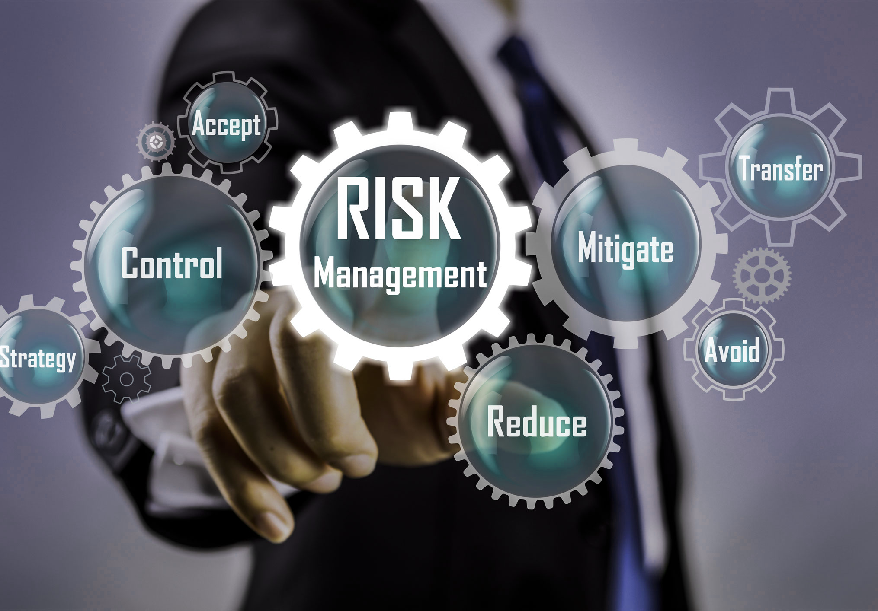
Risks and Dependencies: Risk: In project management, risks are potential events that could negatively impact project goals. They can range from scope creep and budget overruns to communication breakdowns and resource shortages. Effective risk management involves identifying, analyzing, and responding to these potential issues to minimize their impact and ensure project success. However when it comes to risk involvement of enhancement of changes in this applicant, the main risk could be as listed below. 1. External Factors: Unexpected events like market changes, weather, or supply chain disruptions. 2. Poor Performance: Team members or key stakeholders may underperform, leading to delays or quality issues. 3. Operational Risks: Issues with processes, procedures, or implementation that can impact project outcomes. 4. Market Risks: Changes in market demand, competition, or regulatory environments. In order for us to mitigate these risks we need to follow below steps. 1. Risk Identification: Identify potential risks by brainstorming, analyzing project documentation, and reviewing existing documents of this project. 2. Risk Analysis: Assess the likelihood and impact of identified risks. 3. Risk Prioritization: Focus on the risks with the highest likelihood and impact. 4. Risk Response Planning: Develop strategies to mitigate, avoid, or transfer risks. 5. Risk Monitoring and Control: Track risks, identify new risks, and update risk plans throughout the project lifecycle. But as the current application in place and users and not finding it difficult for doing the tasks in hand, however if we get these changes in the current application, we could help in getting the work easy and also could help in reducing the work hours spent in such misc. activities and deliver the customer with much lower TAT.

Slide 11
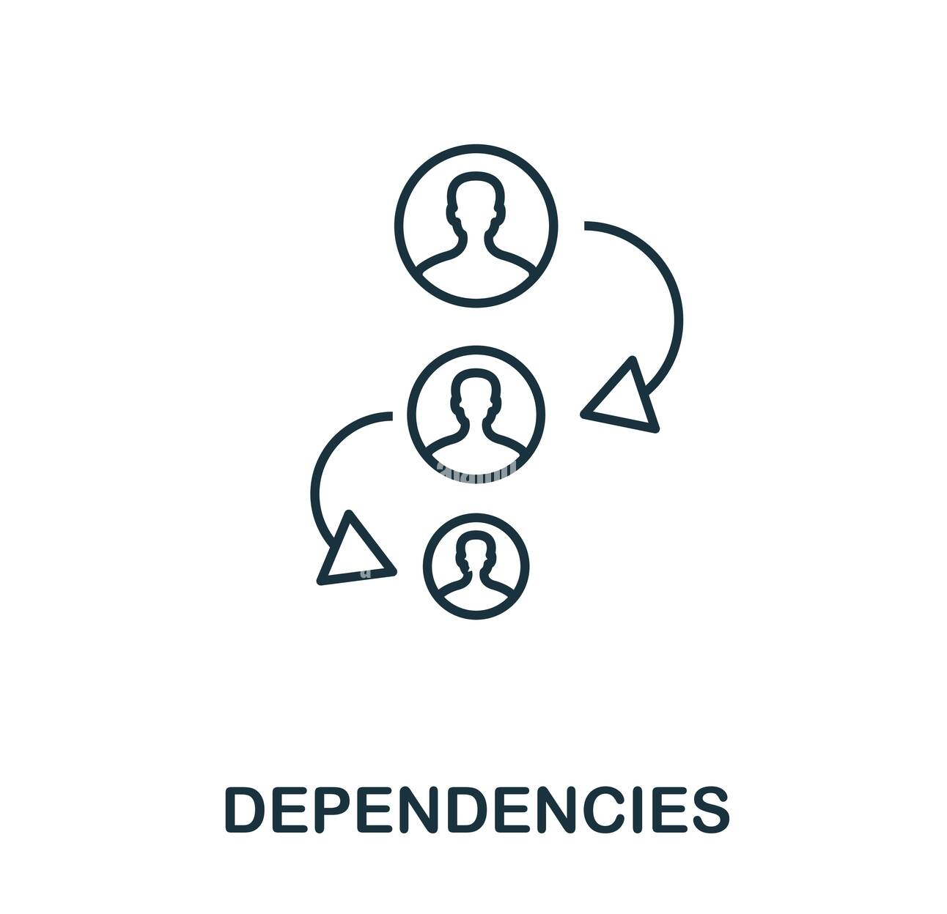
Dependencies: In project management, dependencies refer to the relationships between tasks where one task relies on the completion or initiation of another. These dependencies are crucial for ensuring the logical order of project activities and maintaining the overall project schedule. Understanding and managing dependencies helps project managers optimize workflows, mitigate risks, and ensure timely project completion. Some of major dependencies could be: 1. Internal Dependencies: These are tasks within the project's scope that depend on the completion of other internal tasks. 2. External Dependencies: These are tasks that depend on factors outside the project's control, such as relying on another team or an external resource. 3. Finish-to-Start (FS): The most common type, where a predecessor task must finish before the successor task can begin. 4. Start-to-Start (SS): Both predecessor and successor tasks must begin at the same time. 5. Finish-to-Finish (FF): Both predecessor and successor tasks must finish at the same time. 6. Start-to-Finish (SF): The successor task must finish before the predecessor task can start. But in order to manage these dependencies we can follow below steps: 1. Ensures Logical Order: Proper dependency management ensures tasks are completed in the correct sequence, preventing delays and bottlenecks. 2. Optimizes Workflows: By understanding how tasks are interconnected, project managers can optimize workflows and minimize wasted time and effort. 3. Mitigates Risks: Identifying dependencies proactively allows project managers to anticipate potential risks and develop contingency plans. 4. Improves Communication: Understanding dependencies fosters better communication and collaboration among team members. 5. Facilitates Decision-Making: A clear understanding of dependencies empowers project managers to make informed decisions about resource allocation, scheduling, and risk management.

Slide 12
THANK YOU

