Slide 1

Online Agriculture Products Store

Slide 2
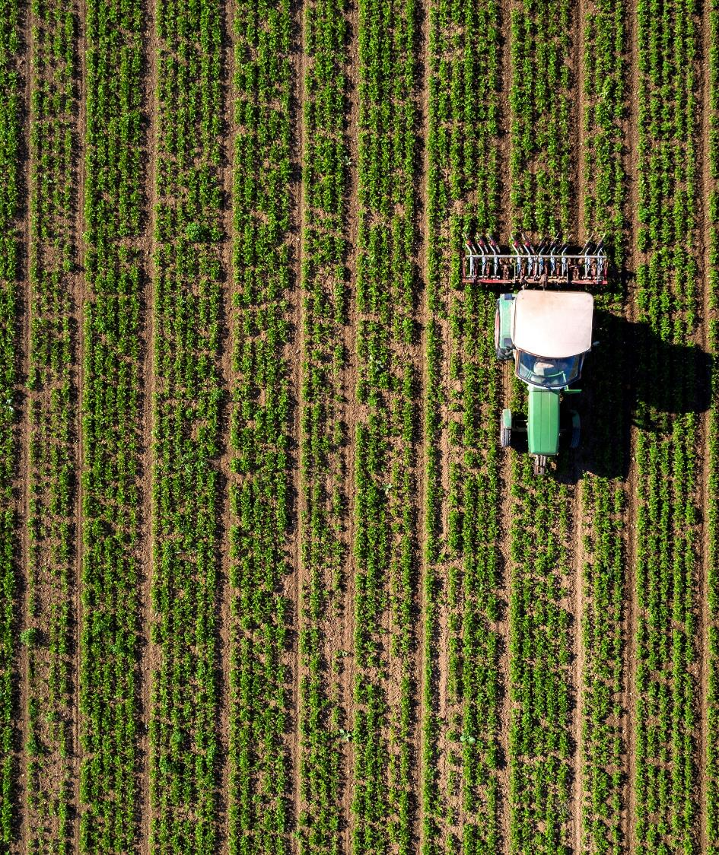
Question 1 Identify Business Process Model for Online Agriculture Store
Goal: To Develop an online agriculture store for remote area farmers to purchase seeds, pesticides, and fertilizers
Input: Product details from manufacturers, farmer requirements, Order Requests
Resources: Online platforms, Internet connectivity, Warehouses
Output: Orders, Product Delivery, Improving Forming efficiency
Activities: Registration, selecting products, placing orders, Payment, delivery tracking
Value Created: Increased accessibility to farmers, enhanced farming productivity, ease of farming

Slide 3
Question 2 SWOT analysis
Strengths:
Direct manufacturer-to-farmer model
Accessibility for remote farmers digitally
Weakness:
Internet connectivity
farmers digital literacy
Threats:
Competition from established Agro-businesses.
Logistical and delivery challenges in remote areas.
Opportunities:
Expansion to other regions
Include advisory services to farmers

Slide 4

Question 3 Feasibility study
Hardware: Server infrastructure for hosting the platform.
Software: Java-based mobile and web application.
Resources: Java developers, Network admin, DB admin, Testers
Budget: 2CR
Timeframe: 18Months

Slide 5
Question 4 Risk Analysis
Internal Risks:
Dependence on external vendors for product supply and inventory management
Logistic issues in delivering remote areas
Technical issues and system downtime can affect the farmer’s experience
External Risks:
Intense competition from other Agro-business in India
Changes in government regulations and policies that affect industry
BA Risks:
Incomplete requirements
Domain
Change in requirements
Project-based risks:
Scope risks
Stakeholder risks

Slide 6
Question 5 Gap Analysis
AS-IS Process:
Rely only on physical markets
Limited access to a variety of quality seeds, fertilizers, and pesticides.
Unavailability of products.
Higher costs due to intermediaries and transportation.
TO-BE Process:
Farmers can directly purchase products from manufacturers vie an online platform.
Wide range of high-quality seeds, fertilizers and pesticides available in one place
Transparency in pricing, availability and quality

Slide 7
Question6 Stakeholder Analysis (RACI Matrix)
 | Name | Designation | Category
Responsible | Ms Juhi | Senior Java Developer | Technical Stakeholders
 | Mr Tyson | Java Developer | Technical Stakeholders
 | Mr Lucie
 | Mr Tucker
 | Mr Bravo
Accountable | Mr Karthik | Delivery Head | Key Implementer
 | Mr Vandanam | project Manager | Key Implementer
 | Mr Gopi | Business Analyst | Key Implementer
Consulted | Mr John | DB Admin | Technical Stakeholders
 | Mr Mike | Network Admin | Technical Stakeholders
Informed | Mr Henry | Sponsor | Primary Decision-Maker
 | Mr Pandu | Financial Head | Primary Decision-Maker
 | Mr Dooku | Project Co-Ordinator | Primary Decision-Maker

Slide 8
Question 7 Business Case Document
Objective:
Improve accessibility of agricultural products for remote farmers.
Scope:
Development of an online store accessible via web and mobile.
Benefits:
Reduced cost to the farmers because of direct manufacturer-to-farmer transactions, improved agricultural output.
Risks:
Internet connectivity in rural areas, Low digital literacy in farmers
Resource:
Hardware: Server infrastructure for hosting the platform.
Software: Java-based mobile and web application.
Resources: Java developers, Network admin, DB admin, Testers

Slide 9
Change Management Approach:
Implement a pilot launch in selected regions before full rollout
Gather feedback and iterate to refine the system for better adoption
identifying Stakeholder:
Stakeholders can be identified based on their influence, interest, and role in the project. The key methods to identify them include:
    Analyzing Business Needs
    Understanding who will use, fund, or be affected by the project.
    Conducting Interviews & Surveys
    Engaging with potential stakeholders to gather requirements.
    Reviewing Organizational Structure
    Identifying decision-makers and key influencers.
    Using RACI Matrix
    Categorizing stakeholders based on their responsibility in the project.

Slide 10
Question8 SDLC Methodologies
Sequential, Iterative, Evolutionary, and Agile Each methodology. Has its advantages and is suited to different project requirements.
Sequential:
The Sequential follows a linear and structured approach where each phase (Requirement Analysis, Design, Development, Testing, Deployment, and Maintenance) is completed before moving to the next stage.
Characteristics:
Strict phase-wise execution.
No overlapping between phases.
Testing occurs after development.
Best Used For: Large projects with stable and well-defined requirements, such as banking or ERP systems.

Slide 11
Iterative Model (RUP - Rational Unified Process)
Definition:
The Iterative Model breaks the project into smaller cycles (iterations). Each iteration includes planning, design, development, and testing, gradually refining the product over multiple cycles.
Characteristics:
Development occurs in multiple iterations.
Each cycle adds new functionality.
Feedback from previous iterations is incorporated into the next.
Best Used For: Projects where requirements may evolve but follow a structured approach, such as large-scale enterprise applications.

Slide 12
Evolutionary Model (Spiral Model)
Definition:
The Spiral Model is a risk-driven approach that combines elements of both the Waterfall and Iterative models. It follows a cyclical process where each phase involves risk assessment before proceeding.
Characteristics:
Focuses on risk analysis and continuous prototyping.
Each cycle (spiral) includes planning, risk analysis, engineering, and evaluation.
Gradually improves with each iteration.
Best Used For: Large-scale systems with high complexity and risks, such as defense or aerospace projects.

Slide 13
Agile Model (Scrum)
Definition:
The Agile Model focuses on flexibility, adaptability, and customer collaboration. It follows an incremental and iterative development process, delivering a working product in short sprints.
Characteristics:
Work is divided into small sprints (2-4 weeks).
Continuous customer feedback is incorporated.
Teams work in collaborative and cross-functional settings
Best Used For: Startups, web applications, AI-based projects, and software with rapidly changing user needs.

Slide 14
Question 9 – Waterfall RUP Spiral and Scrum Models
Waterfall Model:
The Waterfall Model was the first Process Model to be introduced. It is also referred to as a linear-sequential life cycle model. It is very simple to understand and use. In a waterfall model, each phase must be completed before the next phase can begin and there is no overlapping in the phases.
Requirement Gathering and analysis, System Design, Implementation, Integration and Testing,Deployment of system, Maintenance
Spiral Model:
The spiral model has four phases. A software project repeatedly passes through these phases in iterations called Spirals.
Identification, Design, Construct or Build, Evaluation and Risk Analysis
The Spiral Model is widely used in the software industry as it is in sync with the natural development process of any product, i.e. learning with maturity which involves minimum risk for the customer as well as the development firms.

Slide 15
Scrum:
Scrum is a framework that helps teams work together to achieve goals. It's commonly used in software development, but its principles can be applied to other types of teamwork.
How Scrum works
Sprints: Teams break work into time-boxed iterations called sprints, usually lasting two weeks.
Roles: Scrum includes roles like the product owner, scrum master, and developers.
Meetings: Scrum includes meetings like sprint planning, daily scrum, sprint review, and sprint retrospectives.
Values: Scrum values include commitment, courage, focus, openness, and respect.
RUP:
Rational Unified Process (RUP) is a framework for software engineering processes. RUP is an Iterative and incremental approach to improving problem knowledge through consecutive revisions. It is an architecture-centric and use-case-driven approach that manages risk and is flexible to change. RUP incrementally improves an effective solution through repeated iterations.
There is a total of five phases of the life cycle of RUP:
Inception, Elaboration, Construction, Transition, Production

Slide 16
Question 10 Waterfall Vs V-Model
Aspect | Waterfall Model | V-Model
Approach | Sequential, phase-by-phase execution. | Verification and validation run in parallel.
Testing | Begins after the development phase is completed. | Testing occurs at each development stage.
Flexibility | Rigid, changes are difficult to incorporate. | More flexible, as defects are detected early.
Risk Handling | Higher risk, as issues are found later. | Lower risk, as defects are identified early.
Feedback | Late-stage feedback after full development. | Early feedback due to continuous testing.
Documentation | Heavy documentation required before proceeding. | Comprehensive documentation at each phase.
Best Used For | Well-defined projects with stable requirements. | Projects where quality and early defect detection are crucial.
Time to Market | Longer, as testing is at the end. | Shorter, as testing runs parallel to development.

Slide 17
Question 11 – Justify your choice choosing one model for this project
Chosen Model: V-Model.
Justification: Since testing is integrated at each development stage, it ensures a higher-quality product, reduces rework, and aligns well with project requirements.

Slide 18
Question 12 Gantt chart
Phase | Description | Duration (Weeks) | Resources Involved
RG | Requirement Gathering | 6 | PM, BA
RA | Requirement Analysis | 6 | BA, Developers
Design | System & UI/UX Design | 8 | Developers, DB Admin
D1 | Development Phase 1 (Core Features) | 10 | Developers
T1 | Testing Phase 1 | 6 | Testers
D2 | Development Phase 2 (Enhancements) | 10 | Developers
T2 | Testing Phase 2 | 6 | Testers
D3 | Development Phase 3 (Final Features) | 8 | Developers
T3 | Testing Phase 3 | 6 | Testers
D4 | Final Development Fixes | 6 | Developers
T4 | Final Testing & QA | 6 | Testers
UAT | User Acceptance Testing & Handover | 8 | Testers, End Users

Slide 19
Question 13 fixed bid vs billing projects
A fixed bid project is one in which the service provider agrees to deliver a specific scope of work for a fixed price. The scope of work, deliverables, and timeline are agreed upon upfront, and the service provider assumes the risk for any cost overruns or delays.
A billing project is one in which the service provider bills the client for the actual times and materials expended on the project. The client pays for the service provider's time and expenses, and the scope of work can be adjusted as needed throughout the project

Slide 20
Design Timesheet of a BA
Duration: 6-8 Weeks
Question 14 – Preparer Timesheets of a BA in various stages of SDLC
Task | Estimated Hours | Comments
Wireframing & UI/UX Prototyping | 40-60 | Collaborate with UI/UX teams
Data Flow & Process Diagrams | 30-50 | Define system processes
Functional Specification Document (FSD) | 50-70 | Detail business logic
Review & Approval Meetings | 20-30 | Validate with stakeholders

Slide 21
Testing Timesheet of a BA
Task | Estimated Hours | Comments
Unit Testing Validation | 40-60 | Work with testers to validate logic
Test Case Review | 30-50 | Align business expectations
Test Case Review | 40-60 | Collaborate with QA team
Defect Triage & Prioritization | 30-50 | Address system issues
Integration Testing Validation | 40-60 | Ensure modules work together
Business Logic Testing | 30-50 | Verify calculations & w
Development Timesheet of a BA
Task | Estimated Hours | Comments
Clarifications to Developers | 50-70 | Continuous support
Refinement of Change Requests | 40-60 | Handling evolving business needs

Slide 22
UAT Timesheet of a BA
ask | Estimated Hours | Comments
UAT Scenario Preparation | 30-50 | Define key user test cases
UAT Execution & Monitoring | 40-60 | Work closely with users
Issue Resolution | 40-60 | Coordinate fixes with developers
Final Sign-off & Approval | 20-30 | Handover to production
Deployment &Implementation Timesheet of a BA
Task | Estimated Hours | Comments
Go-Live Readiness Review | 30-40 | Ensure system stability
Training & User Documentation | 30-50 | Conduct end-user training
Post-Go Live Support | 50-70 | Handle early-stage issues
Transition to Operations | 30-40 | Handover to IT support teams

Slide 23
Thank You

