Slide 1
Renewable Energy Integration
Prepared by: Nilansh Kohli

Slide 2
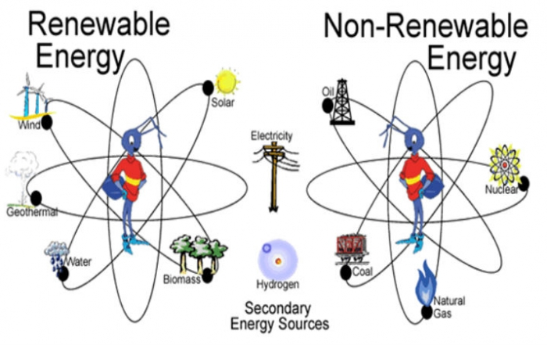
Situation
Renewable energy sources, such as solar and wind, are increasingly becoming a priority to reduce dependency on non-renewable resources.
Power grids, however, often lack the infrastructure and technology to effectively integrate these renewable sources.
With global zero-emission goals, there is a pressing need to adopt structured solutions for energy transition.

Slide 3
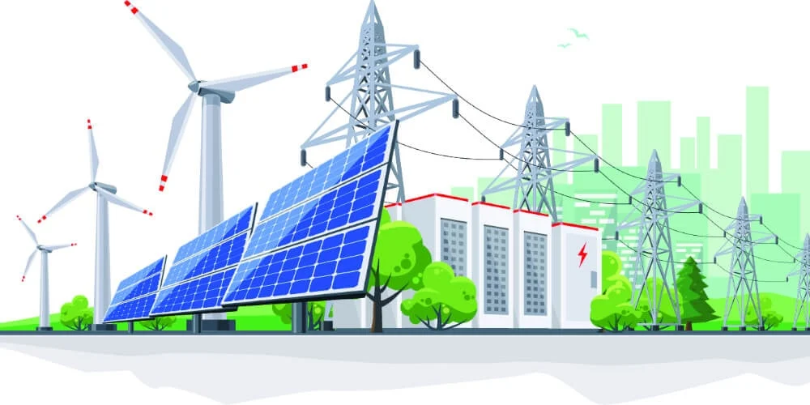
Challenges in Renewable Energy Integration
Fragmented infrastructure makes it difficult to connect renewable sources to existing power grids.
Inefficiencies in resource utilization lead to energy wastage and grid instability.
Limited monitoring and adaptability hinder the seamless flow of renewable power to end users.

Slide 4

Potential for Sustainable Energy Solutions
Develop robust, scalable systems that integrate renewable energy sources into power grids efficiently.
Contribute to zero-emission goals while ensuring energy security and grid stability.
Position as leaders in green energy innovation, setting an example for global sustainable practices.

Slide 5
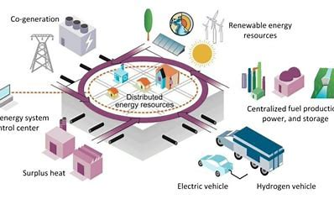
Purpose of the Project
The purpose of this project is to design, develop, and implement a solution for integrating renewable energy sources, such as solar and wind, into existing power grid systems using a structured, systematic approach.
This project aims to address inefficiencies, enhance grid reliability, and support zero-emission goals.

Slide 6
Objectives of Renewable Energy Integration
Develop a scalable integration strategy aligned with design criteria and renewable energy specifications.
Create a prototype solution for seamless integration of renewable energy into grid systems.
Evaluate system performance through comprehensive testing procedures.
Ensure energy efficiency and grid stability with advanced monitoring frameworks.
Train stakeholders for effective adoption and usage of the new system.

Slide 7

Defining Project Success
Achieve 90% efficiency in integrating renewable energy sources into the grid.
Replace 50% of non-renewable energy generation within the first year to reduce carbon footprint.
Ensure system reliability by reducing grid downtime and maximizing uptime for renewable power contributions.

Slide 8
Methods/Approaches to Renewable Energy IntegratioN:
Requirement Analysis Phase
Establish Selection Committee**: Form a cross-disciplinary team of stakeholders (engineers, policymakers, business analysts) to oversee renewable energy integration.
Define System Requirements**: Identify technical, financial, and environmental requirements (e.g., grid capacity, renewable energy source compatibility).
Assess Existing Infrastructure**: Conduct a gap analysis to determine what changes/upgrades are needed to incorporate solar and wind power effectively.

Slide 9
Methods/Approaches to Renewable Energy IntegratioN:
Design Phase
Develop a Comprehensive Integration Plan**: Design a system architecture for renewable energy integration. This includes energy storage options and grid enhancements.
Vendor and Technology Research**: Identify potential vendors for solar panels, wind turbines, energy storage solutions, and grid monitoring systems.
Run Simulations: Use tools/software to simulate how the integration will impact existing grid performance and stability.

Slide 10
Methods/Approaches to Renewable Energy IntegratioN:
Implementation Phase
Vendor Selection: Use a Request for Proposal (RFP) process to compare vendors based on performance, cost, and compliance with requirements.
Install Infrastructure and Components**: Implement the hardware (renewable energy generation systems, energy storage) and software (monitoring frameworks, control systems).
User and Technical Staff Training: Provide training programs for operators, technicians, and stakeholders on the new system’s operations.

Slide 11
Methods/Approaches to Renewable Energy IntegratioN:
Verification and Testing Phase
System Testing: Perform end-to-end testing of the integration solution (e.g., load tests, stress tests) to ensure compatibility and performance.
Adjustments and Optimization: Address inefficiencies or bottlenecks identified during testing to ensure smooth energy flow and stability.

Slide 12
Methods/Approaches to Renewable Energy IntegratioN:
Deployment/Go-Live Phase:
Operational Launch: Activate the integrated system and connect renewable energy sources to the grid.
Establish Support Processes: Set up 24/7 monitoring teams and support systems to address real-time issues.
Documentation and Handover: Prepare detailed documentation of the implemented system for future reference and maintenance.

Slide 13
Methods/Approaches to Renewable Energy IntegratioN:
Maintenance Phase
Routine Monitoring and Updates: Implement advanced monitoring frameworks to track performance and identify potential areas of improvement.
Stakeholder Feedback Loop: Regularly collect feedback from stakeholders to improve system efficiency and scalability.

Slide 14
Resources:
People:
Project Managers: Oversee progress and ensure milestones are met.
Renewable Energy Specialists: Design and optimize the integration.
IT Infrastructure Experts: Implement and support technical systems.
Time:
  Estimated Timeline: 9 months.
  3 months for planning and requirements.
  4 months for design and implementation.
  2 months for testing and deployment.

Slide 15
Resources:
Other Resources:
External software evaluations (e.g., GreenTech Solutions).
Site visits to Norway renewable energy facilities.
Insights from Dataquest reports for informed strategies.

Slide 16
Risks involved
Technical Risks:
Incompatibility: Renewable sources may disrupt existing grid systems (e.g., voltage fluctuations).
System Failures: Bugs in software or downtimes may occur during initial rollouts.
Cost-Related Risks:
Budget Overruns: Exceeding planned budgets due to unexpected costs (e.g., hardware or import tariffs).
Low ROI Visibility: Difficulty in showing tangible financial benefits immediately.
Human Resource Risks:
Stakeholder Resistance: Users hesitant to adopt the new system.
Skill Gaps: Lack of expertise among staff handling complex systems.

Slide 17
Risks Involved
Environmental and Regulatory Risks:
Compliance: Changes in renewable energy regulations may delay progress.
Ecological Concerns: Objections regarding local environmental impacts (e.g., wind turbine placement).
External Dependencies:
Vendor Delays: Late deliveries from suppliers.
Third-Party Evaluations*: Prolonged assessments or approval processes.

Slide 18
Dependencies
Existing Infrastructure:
Ensure compatibility with legacy grid systems for renewable energy integration.
Vendor Deliverables:
Timely delivery of key components like solar panels, wind turbines, and batteries.
Third-Party Evaluations:
Conduct software validations and compliance checks from external experts.
Regulatory Compliance:
Adherence to national policies, like India’s National Electricity Plan 2023.
Environmental Approvals:
Obtain ecological assessments to avoid disruptions in sensitive areas.

Slide 19
Sponsor AND PROJECT MANAGER
PROJECT SPONSOR – NILANSH KOHLI
PROJECT MANAGER - GEORGE ADAM

