Slide 1
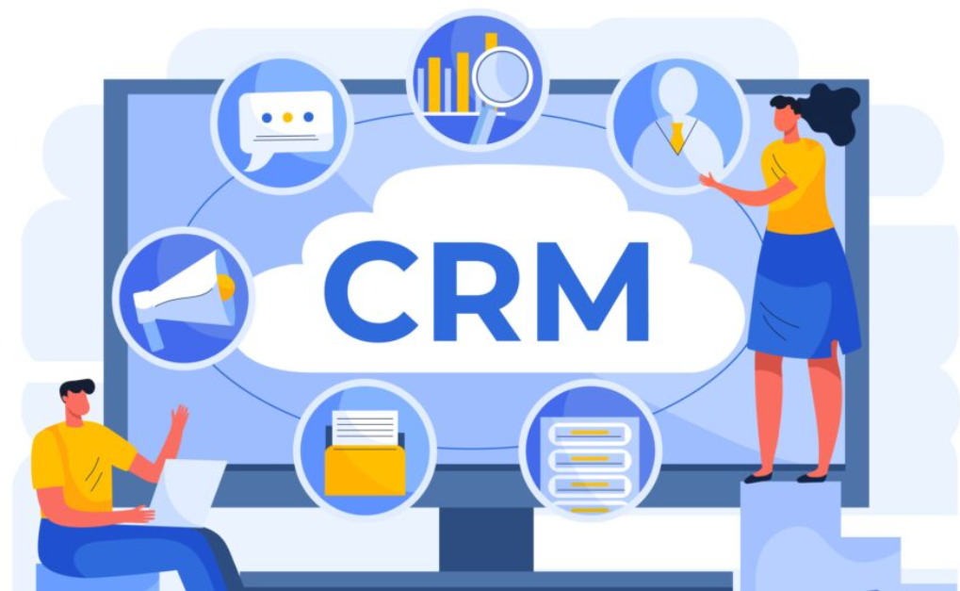
Project title : CUSTOMER RELATIONSHIP management
Prepared By
Mr. Sourav Banerjee
Date :18.04.2025

Slide 2
INTRODUCTION TO CRM
CRM stands for customer relationship management, which is a system for managing all of your company's interactions with current and potential customers. The goal is simple: improve relationships to grow your business.

Slide 3
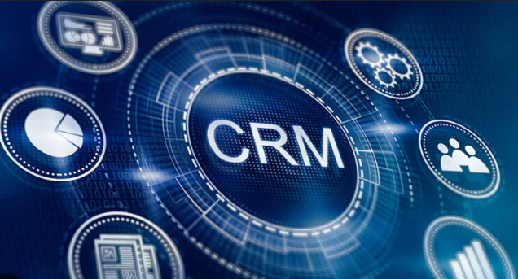
SITUATION
Lack of Proper CRM Training - Without proper training, users may struggle to navigate the CRM interface, leading to underutilization and missed opportunities.
Lack of User Adoption - CRM features remain ineffective if employees don’t actively use them.
Not able to Communicate properly - It creates additional problems to the software implimentation if proper communication is not there between employees and management.
Cost and Resource Constraints - Cost and resource constraints pose substantial challenges for businesses, particularly small ones, in adopting and utilizing CRM systems. Financial limitations often restrict their ability to invest in expensive CRM solutions.

Slide 4

PROBLEM
Resistance to change, arising from employees’ fear of disruption to routines and job security concerns, presents a significant hurdle in CRM adaptation for companies. This reluctance can impede successful implementation efforts, necessitating strategic approaches to overcome employee hesitancy and cultivate acceptance of new CRM systems.
If there is a problem with the communication between employees and management then it creates additional porblem to software implimentaion.
One of the major challenges the business people face while implimenting CRM software is Cost issues.

Slide 5

OPPORTUNITY
Increased Sales: CRM can help identify and nurture leads, improve sales processes, and enable more effective cross-selling and up-selling opportunities.
Improved Customer Satisfaction: By providing a holistic view of customer interactions and preferences, CRM can help organizations personalize experiences, resolve issues faster, and build stronger customer relationships.
Reduced Costs: Automation of tasks, improved efficiency, and better resource allocation can lead to cost savings in areas like customer service and sales operations.
Better Decision-Making: CRM provides valuable data and analytics for informed decision-making, allowing businesses to understand customer behavior, identify trends, and optimize strategies.

Slide 6
PURPOSE STATEMENT (GOALS)
Our CRM strategy aims to empower your sales and marketing teams with the tools and data they need to build stronger customer relationships and achieve your business objectives.
By leveraging the power of CRM, we can create a more customer-centric approach, improve customer satisfaction, and ultimately increase your profitability.
This presentation will demonstrate how implementing a CRM system can transform your customer interactions, streamline your business processes, and drive sustainable growth.
This presentation will outline the key benefits of a CRM implementation, including improved sales performance, enhanced marketing effectiveness, and a more efficient customer service operation.

Slide 7
PROJECT OBJECTIVES
Customer Retention
Customer Acquisition
Customer Profitibility
Increase Productivity of Sales and Ops Team

Slide 8
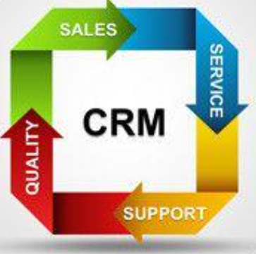
SUCCESS CRITERIA
Sales Performance Improvements: Increased Sales Conversion Rates, Faster Sales Cycles, Increased Sales Revenue.
Operational Efficiency Gains: Reduced Costs , Streamlined Business Processes, Improved Data Management , Better Communication and Collaboration.
Measurable Improvements in Customer Relationships.

Slide 9
METHODS & APPROACHES
Below is the Agile model approach for the CRM enhancement, focusing on the activities for each phase -
1. Agile methodology is used to develop this applicaton. Agile is the iterative development which has the frequent collaboration with stakeholders and allowing for flexibility and responsiveness to changing requirements.
2. Scrum team has aligned to work for this project which has 9-10 members which also includes scrum developers, scrum master and product owner.
3. Requirement gathering where the elicitation tecniques have been applied like brainstorming, use case specifications, JAD sessions and needed elicitations techniques to gather the requirements.
4. Product backlog has been created in the form of user story. User story is nothing but the requirements which we have collected from the stakeholders.
5. All the user stories are prioritize by the MOSCOW and MVP techniques and also by calculating BV and CP points.
6. After the sprint starts, there will be a delivery of the software in two weeks, which can extend if any change requests is there.
7. Sprint meetings will be like daily scrum meeting, sprint review meeting and sprint retrospective meeting will be conducted side by side to update the process and clarify doubts.
8. Once the user story has been done, the user story will be changed to done stage only if the user story is completed. If it is not completed , it has to be in pending table.
9. The product burndown chart will be prepared by the product owner in order to update the work done process.
10. Tools like Jira is mainly used to run the sprint and create product burndown chart and Power BI and Tableau is used to generate documents.
11. If there is any change request, it is welcomed and worked on it accordingly.
12. Finally the sprint retrospective meeting is being held to discuss the what went well in the sprint and what did not went well and what were the complications that occured during the development to ensure successful completion of the project.

Slide 10
Resources
People – 9-10 members which also includes scrum developers, scrum master and product owner are taken in the project.
Time - 2 - 4 Weeks
C. Budget – The overall hours estimated For the project is 1 month and the current team size is 10, hardware ,software, training and services not to exceed Rs 10 L.
D. Other – Third party software evaluation , site visit , data quest reports , not to exceed Rs 20L.

Slide 11


RISKS AND DEPENDENCIES

Slide 12
Identifying Potential Risks:
Training and Skill Gaps: Employees may need training on using the new CRM system.
Ineffective CRM Strategy: Lack of a well-defined CRM strategy can lead to suboptimal results.
Failure to Define Objectives: Not clearly defining CRM goals can lead to a lack of focus and measurement.
Identifying Key Dependencies:
Data Integrity: Data quality and accuracy are crucial for accurate reporting and insights.
User Adoption: Training and effective communication to ensure user adoption of the new system.
Training and Support: Adequate training and ongoing support for users.
Risk Mitigation Strategies:
Establish Clear Communication Channels: Maintain open communication with stakeholders to address concerns and updates.
Secure the CRM System: Implement robust security measures to protect customer data.
Regularly Review and Monitor: Continuously review and monitor the CRM system's performance and identify areas for improvement.

Slide 13
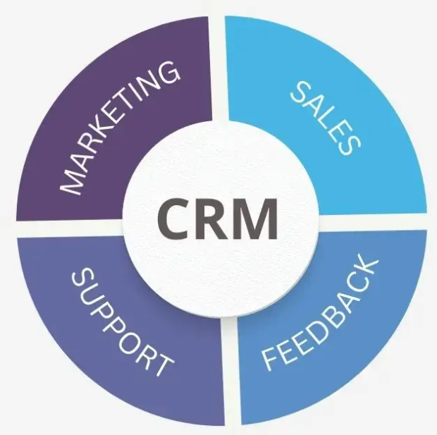
Dependency Management Strategies:
Dependency Risk Assessment: Evaluate the risk associated with each dependency.
Establish Clear Communication Channels: Maintain communication with all stakeholders to manage dependencies.
Regularly Review and Monitor: Continuously review and monitor the dependencies and their impact on the project.

Slide 14

THANK
YOU

