Slide 1


Inventory Management System for
Prilube Industries
(Waterfall Methodology)

Slide 2
Table of contents
  Current Situation at Prilube Industries
  Key Challenges Faced by Prilube Industries
  Opportunities for Improvement
  Project Objectives
  Success Criteria
  Project Phases
  Resource Allocation
  Risks & Mitigation Strategies
  Dependencies
  Budget Overview

Slide 3

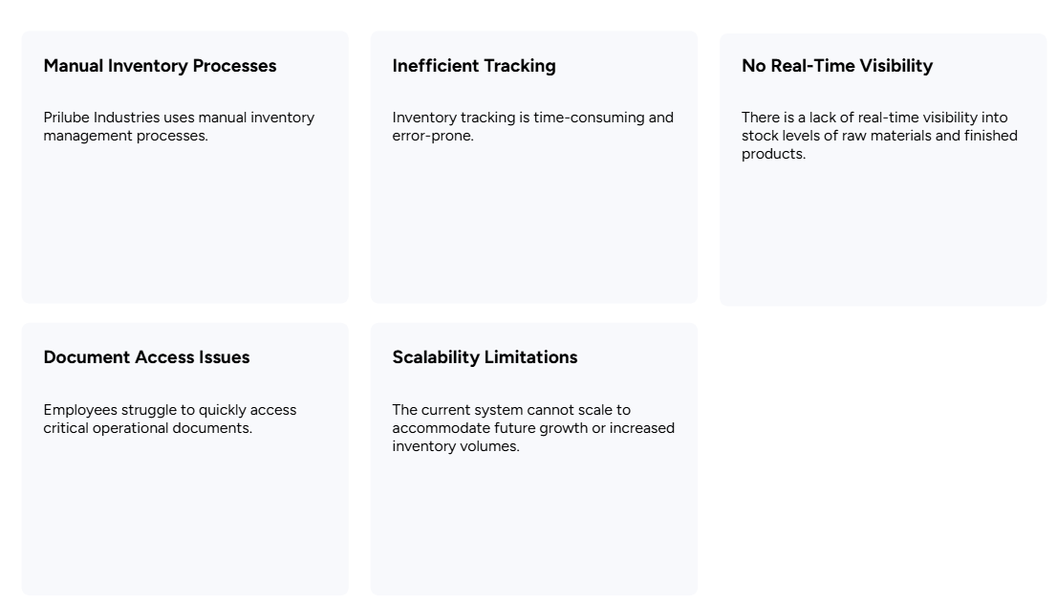
Current Situation at Prilube Industries

Slide 4

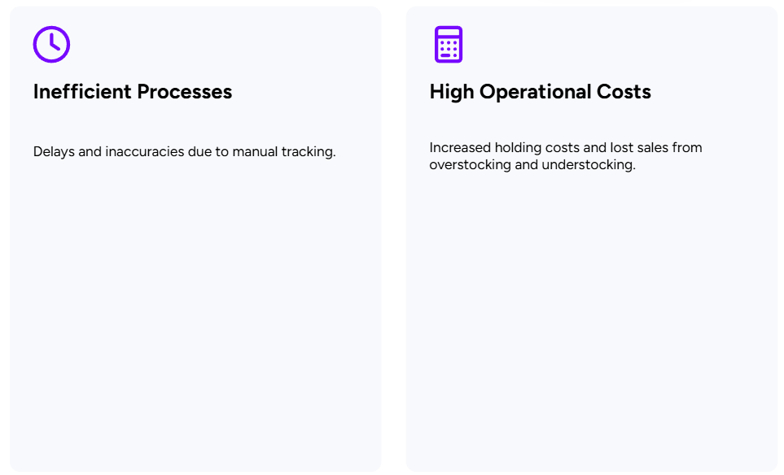
Key Challenges Faced by Prilube Industries

Slide 5
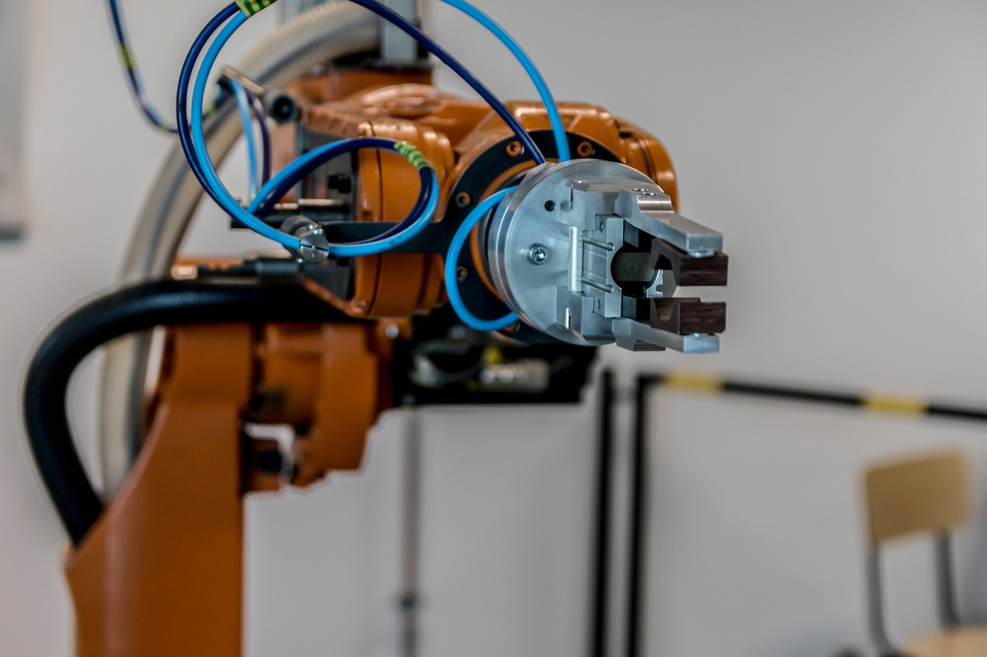
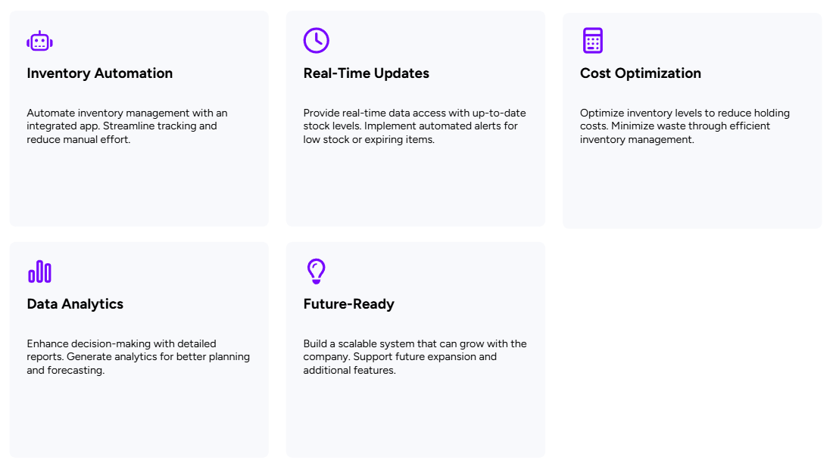
Opportunities for Improvement

Slide 6
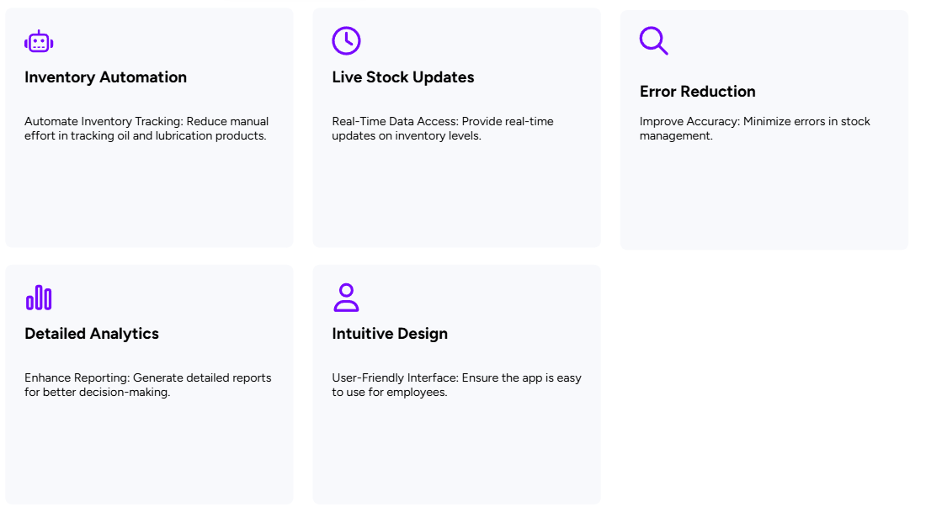
Project Objectives

Slide 7
Problem Statement
The purpose of the Inventory Management Application for Prilube Industries is to design and implement a robust, user-friendly, and efficient system that streamlines the company's inventory management processes. The app aims to achieve the following goals:
  Integration with external ERP systems (unless specified later).
  Advanced predictive analytics or AI-based features.
  Mobile app development (initially, the app will be web-based).

Slide 8

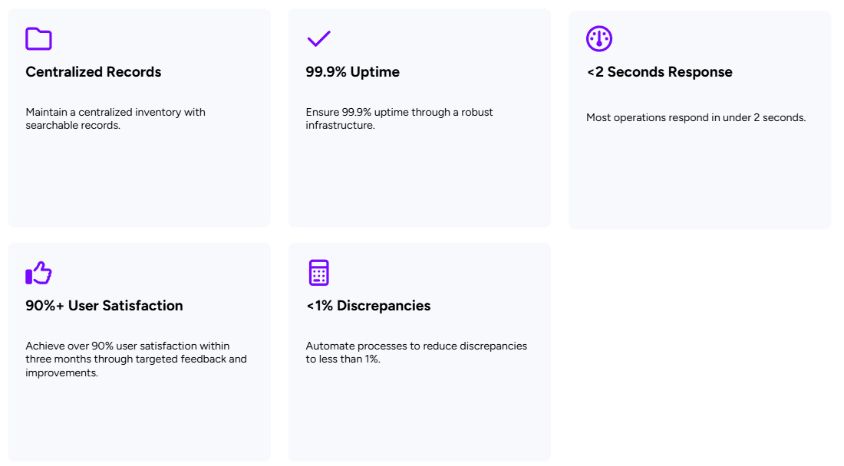
Success Criteria

Slide 9
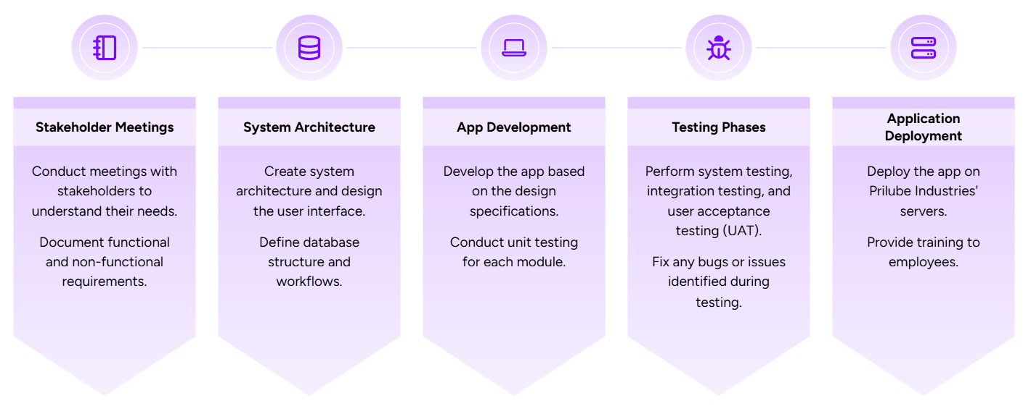
Project Phases (Waterfall Methodology)

Slide 10

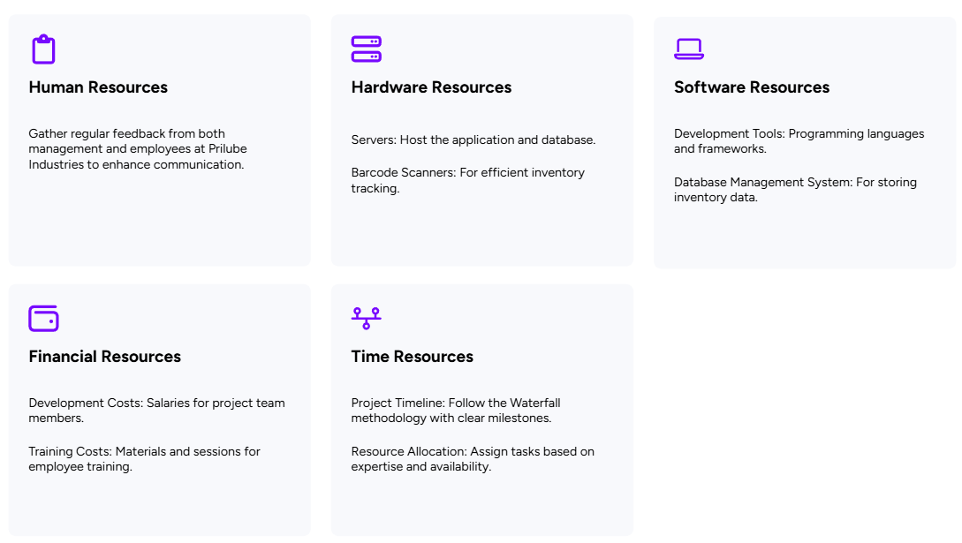
Resource Allocation

Slide 11

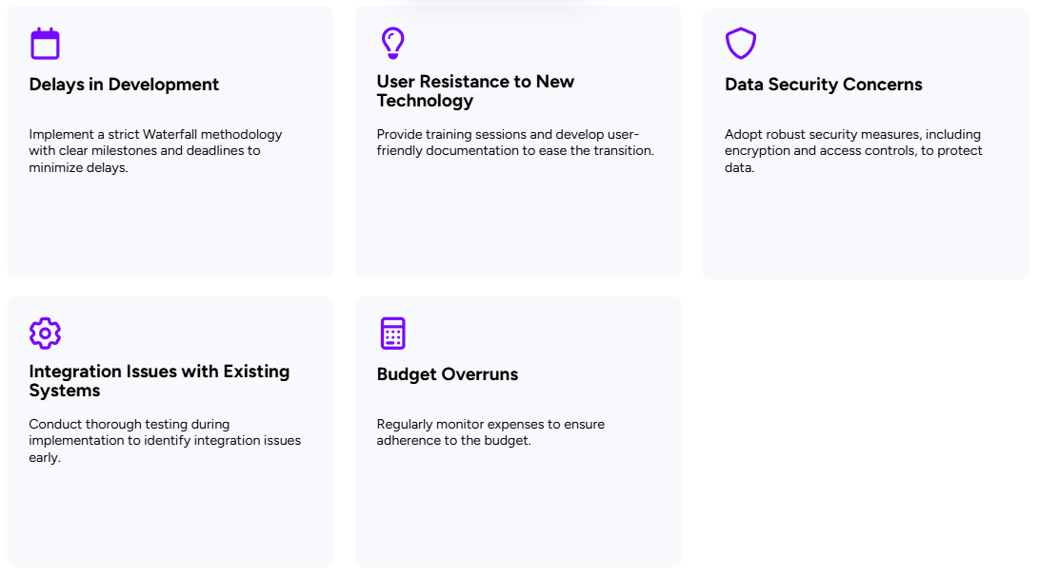
Risks & Mitigation Strategies

Slide 12

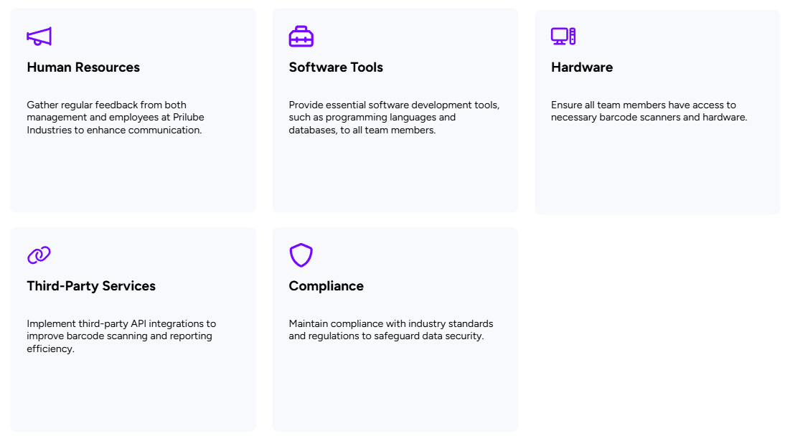
Dependencies

Slide 13

Budget Overview
Development Costs
Software development and project management costs total Rs. 200,000
Hardware Costs
Purchasing or leasing servers, barcode scanners, and other equipment costs Rs. 300,000
Maintenance Costs
Ongoing support and updates post-deployment will cost Rs. 100,000
Total Budget
The total budget amounts to Rs. 600,000 which is the sum of all individual costs.

