Slide 1
Renewable Energy Integration
Prepared by: Nilansh Kohli

Slide 2
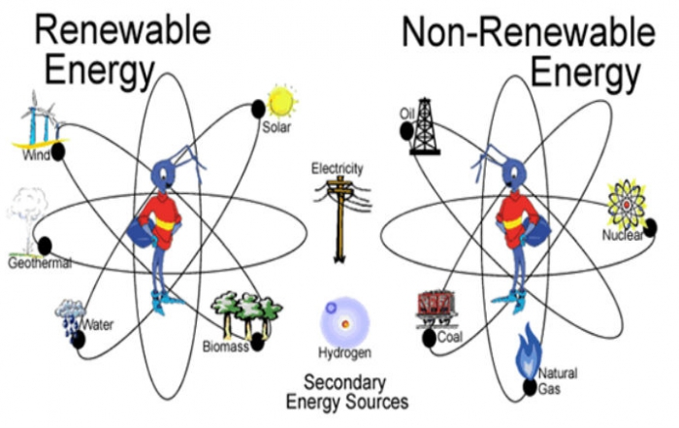
Situation
Renewable energy sources, such as solar and wind, are increasingly becoming a priority to reduce dependency on non-renewable resources.
Power grids, however, often lack the infrastructure and technology to effectively integrate these renewable sources.
With global zero-emission goals, there is a pressing need to adopt structured solutions for energy transition.

Slide 3
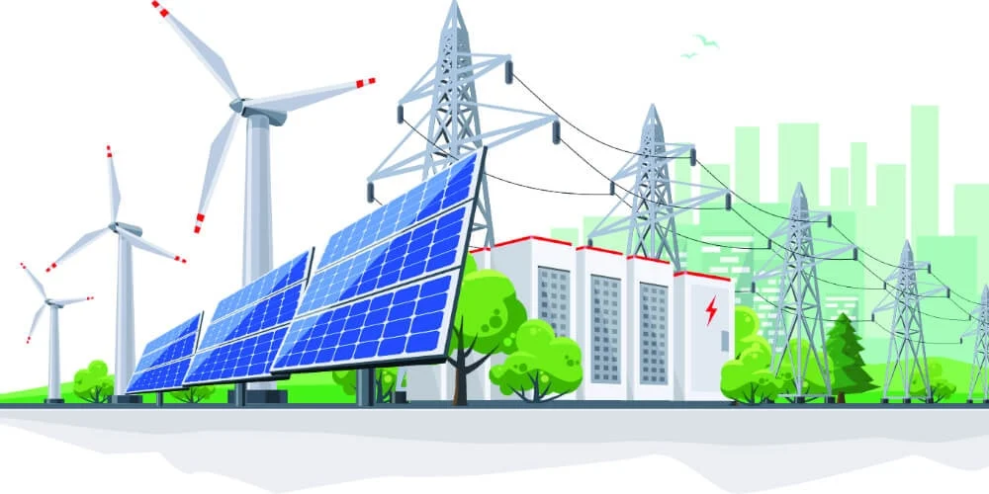
Challenges in Renewable Energy Integration
Fragmented infrastructure makes it difficult to connect renewable sources to existing power grids.
Inefficiencies in resource utilization lead to energy wastage and grid instability.
Limited monitoring and adaptability hinder the seamless flow of renewable power to end users.

Slide 4
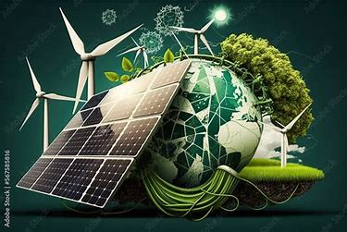
Potential for Sustainable Energy Solutions
Develop robust, scalable systems that integrate renewable energy sources into power grids efficiently.
Contribute to zero-emission goals while ensuring energy security and grid stability.
Position as leaders in green energy innovation, setting an example for global sustainable practices.

Slide 5
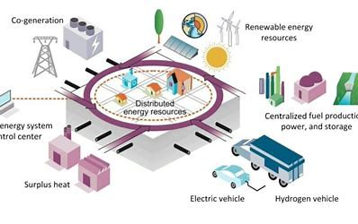
Purpose of the Project
The purpose of this project is to design, develop, and implement a solution for integrating renewable energy sources, such as solar and wind, into existing power grid systems using a structured, systematic approach.
This project aims to address inefficiencies, enhance grid reliability, and support zero-emission goals.

Slide 6
Objectives of Renewable Energy Integration
Develop a scalable integration strategy aligned with design criteria and renewable energy specifications.
Create a prototype solution for seamless integration of renewable energy into grid systems.
Evaluate system performance through comprehensive testing procedures.
Ensure energy efficiency and grid stability with advanced monitoring frameworks.
Train stakeholders for effective adoption and usage of the new system.

Slide 7
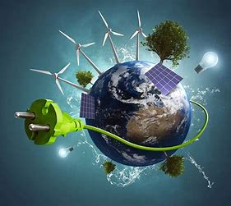
Defining Project Success
Achieve 90% efficiency in integrating renewable energy sources into the grid.
Replace 50% of non-renewable energy generation within the first year to reduce carbon footprint.
Ensure system reliability by reducing grid downtime and maximizing uptime for renewable power contributions.

