Slide 1
Chemical Equipment Project Management Application
Prepared by: Sarath Guru Raj A.V.R Date : 24.02.2025

Slide 2
Situation/Problem/Opportunity
Situation
The chemical industry with traditional project management method faces increasing complexity in equipment management, requiring a structured and efficient approach to handle large-scale installations and maintenance
Safety and regulatory compliance manual tracking increase the risk of regulatory violations and penalties necessitating real-time monitoring and robust documentation.
Equipment downtime can significantly impact production schedules, leading to financial losses and operational inefficiencies.
With rapid technological advancements, industries need to integrate digital solutions to optimize resource allocation and improve overall project execution
Problems
Current project workflows lack flexibility, making it difficult to adapt to unforeseen circumstances such as equipment failures or regulatory changes.
Ineffective communication and collaboration between teams result in project delays and inefficiencies.

Slide 3
Situation/Problem/Opportunity
The absence of predictive analytics and automation leads to reactive maintenance rather than proactive problem-solving.
Compliance tracking is largely manual, increasing the risk of regulatory violations and penalties.
High maintenance costs due to unplanned shutdowns and inefficient scheduling impact overall profitability.
Opportunities
Implementing an Agile-based project management application can introduce flexibility and adaptability to chemical equipment management.
Real-time tracking and automated workflow systems can significantly reduce project delays and enhance operational efficiency.
Integration of digital compliance tracking like IoT and AI-driven predictive maintenance tools can shift maintenance from a reactive to a proactive approach, minimizing unplanned downtimes, reducing compliance risks
The new application will enable cross-functional collaboration through centralized dashboards and real-time data sharing, fostering better decision-making.

Slide 4
Purpose Statement (Goals)
Goal Overview
To introduce an Agile-based Chemical Equipment Project Management Application that enhances operational efficiency by reducing delays, improving communication, minimizes downtime, and ensures regulatory compliance.
By integrating real-time monitoring, AI-driven predictive maintenance, and automated workflow management, the application will streamline project execution and reduce regulatory risk and cost optimization.
Ultimately, this project aims to transform traditional chemical equipment management practices into a highly adaptable and technology-driven approach by implementation of an agile frameworks

Slide 5
Project Objectives
Short Term Objectives
Define and implement structured Agile workflows for chemical project management, ensuring step-by-step progress tracking.
Ensure smooth execution of equipment installation and maintenance projects. Implement digital checklists and automated workflows.
Reduce project risks and execution delays by adopting structured sprint planning & implement a continuous feedback
Provide real-time status updates through cloud based agile platform which are accessible to all stakeholders for improved decision-making.
Long Term Objectives
Improve safety compliance and risk assessment adherence by 50% by integrating real-time safety monitoring tools to minimize hazards
Utilize AI driven algorithms to analyze equipment performance and historical trends and predict potential failures.
Achieve a 25% reduction in project execution costs by optimizing resource allocation and minimizing delays.
Reduce project completion time and cost overruns and also increase project efficiency by 40% through by implementing Agile best practices.

Slide 6
Success Criteria
Agile methodology should be fully integrated into project workflows with measurable improvements.
Equipment downtime must be reduced by at least 30% through predictive maintenance using IoT & AI also provide live dashboard in real time tracking using IOT sensors.
Ensure adherence to ISO, OSHA and industry regulations with built in improving audit efficiency by 40%.
Real-time data visibility should be accessible to all stakeholders and provide user friendly multi platform interface through the new application to access data from any location.
Reduction in project execution errors by automating task dependencies and approvals.
Achieve cost savings of at least 20% by optimizing resource allocation and reducing unplanned shutdowns.
Implement an effective feedback loop for continuous improvement in project execution.
Enable seamless integration with enterprise systems compatibility with ERP, SCADA, and other industrial management platforms.
Ensure 99.9% uptime with cloud-based infrastructure and optimized performance monitoring.
Send real-time notifications for milestone completions, delays, and risk events. And support multi-project execution and future enhancements like block chain security and AI-driven process optimization.
At least 80% of project teams should actively use the Agile project management platform.
.

Slide 7
METHODS
Here we use the AGILE METHODOLOGY,
Agile is a flexible, iterative approach to project management that focuses on delivering value quickly and efficiently.
Unlike the traditional Waterfall model, Agile promotes incremental development through sprints.
Unlike other methods of agile like Kanban, and Lean. Scrum is better suited for projects requiring structured delivery, clear task ownership, and sprint-based execution.
Agile breaks projects into small, manageable tasks, ensuring continuous improvement and risk mitigation.
Agile follows a cycle of planning, execution, review, and iteration in short bursts (sprints).
Sprint Planning: Teams define tasks and break them into smaller units with clear goals for each sprint.
Daily Stand-Ups: Regular meetings keep team members aligned on priorities and blockers.
Task Execution: Teams work in time-boxed cycles to complete specific project deliverables.
Sprint Reviews: Each sprint ends with a retrospective to improve processes.
Continuous Improvement: Feedback from previous sprints is integrated into the next sprint cycle.
Collaboration Across Teams: Agile fosters coordination among engineers, compliance officers, IT teams, and vendors.
How It Fits in this Project: Agile enables faster installation cycles, predictive maintenance implementation, and regulatory compliance tracking.

Slide 8
Approach
Project Roadmap & Agile Framework Selection: Define the requirements and scope, create an Agile roadmap, Conduct vendor demonstration and shortlist the solution and select appropriate frameworks such as Scrum.
Sprint Planning & Backlog Prioritization: Identify key project milestones for chemical equipment tracking and divide them into multiple 2-4 week sprints.
User Stories & Task Breakdown: Create detailed user stories related to equipment installation, shutdowns, and maintenance workflows.
Cross-Functional Team Collaboration: Developers, engineers, IT specialists, and plant managers work collaboratively in sprint reviews.
Daily Stand-Ups & Progress Tracking: Use daily stand-up meetings and Agile tracking tools (Jira, Monday.com) for real-time progress.
Integration of IoT & AI Tools in Agile Execution: Connect IoT sensors for predictive maintenance and AI for automated risk assessments.
Sprint Reviews & Continuous Feedback Loops: After each sprint, review successes, document lessons learned, and adjust priorities.
Automated Reporting & Compliance Tracking: Generate real-time reports that ensure compliance with industry safety regulations.
Scalability & Full Deployment: Once tested in pilot projects, in selected plants or maintenance teams then expand Agile project execution across all chemical facilities.
Post-Implementation Support & Continuous Improvement: Establish ongoing Agile iterations for continuous enhancements and industry adaptability

Slide 9
Resources Allocation
People Resources
Cross-functional project team: chemical engineers, Project managers, IT teams, Field Technicians, Compliance Officers, Executives
Agile coaches and trainers like SME’s guiding the transition from traditional to Agile methodologies
Budgets & Time Resources
Time: 6-12 months based on scope, including training and testing, sprint duration for each spring cycle will last 2 – 4 weeks focusing on specific project milestones.
Budget: Hardware: Rs. 50,00,000 for IoT-enabled monitoring devices and cloud servers.
Software: Rs. 20,00,000 for Agile project management tools (Jira, Trello, Asana).
Training: Rs. 10,00,000 for Agile certification, workshops, and employee upskilling.
AI & IoT Integration: Rs. 20,00,000 for predictive analytics, automation, and smart reporting.
Consulting & Compliance: Rs. 10,00,000 for third-party audits and compliance evaluations
Other Resources
Development tools, testing software, and project management tools.
Third-party audits for vendor selection and security compliance.
Data integration across existing ERP & SCADA systems.
Periodic evaluation of Agile implementation success through KPIs.

Slide 10
Risks and Dependencies
Risks
1. Technical Risks
System Integration Issues: like existing legacy systems may not be fully compatible with Agile tools.
Cloud-based project tracking systems require strong data protection and access controls.
2. Financial Risks
High Initial Investment: The cost of software, IoT devices, and AI integration may strain project budgets.
The benefits of Agile implementation may take longer to quantify in financial terms make ROI uncertainty
3. Project Management Risks
Employees and managers may be reluctant to adopt Agile due to existing workflows.
A lack of adequate training can lead to inefficient Agile adoption and lower productivity.
Dependencies
Internal Dependencies
Successful implementation relies on cloud platforms, IoT connectivity, and AI analytics.
Employees must be trained in Agile tools like Jira, Asana, or Trello.
2. External Dependencies
Agile frameworks must align with regulatory approval like OSHA, ISO, and chemical safety standards.
Effective implementation requires reliable software providers and AI integration partners.

Slide 11
Conclusion and Next Steps
Next Steps
Agile Training & Tool Deployment – Train teams on Agile workflows and deploy project management tools (Jira, Trello, etc.).
Pilot Testing & Evaluation – Implement IoT-based monitoring in selected plants and gather feedback for refinement.
Full-Scale Implementation – Expand Agile adoption across all operations, integrating AI-driven predictive maintenance.
Conclusion
Enhanced Project Execution – Agile improves flexibility, reduces downtime, and streamlines chemical equipment management.
Optimized Collaboration & Compliance – Digital workflows ensure better coordination and regulatory adherence.
Future Scalability – Agile methodologies and AI analytics set the foundation for continuous industry-wide improvements.

Slide 12
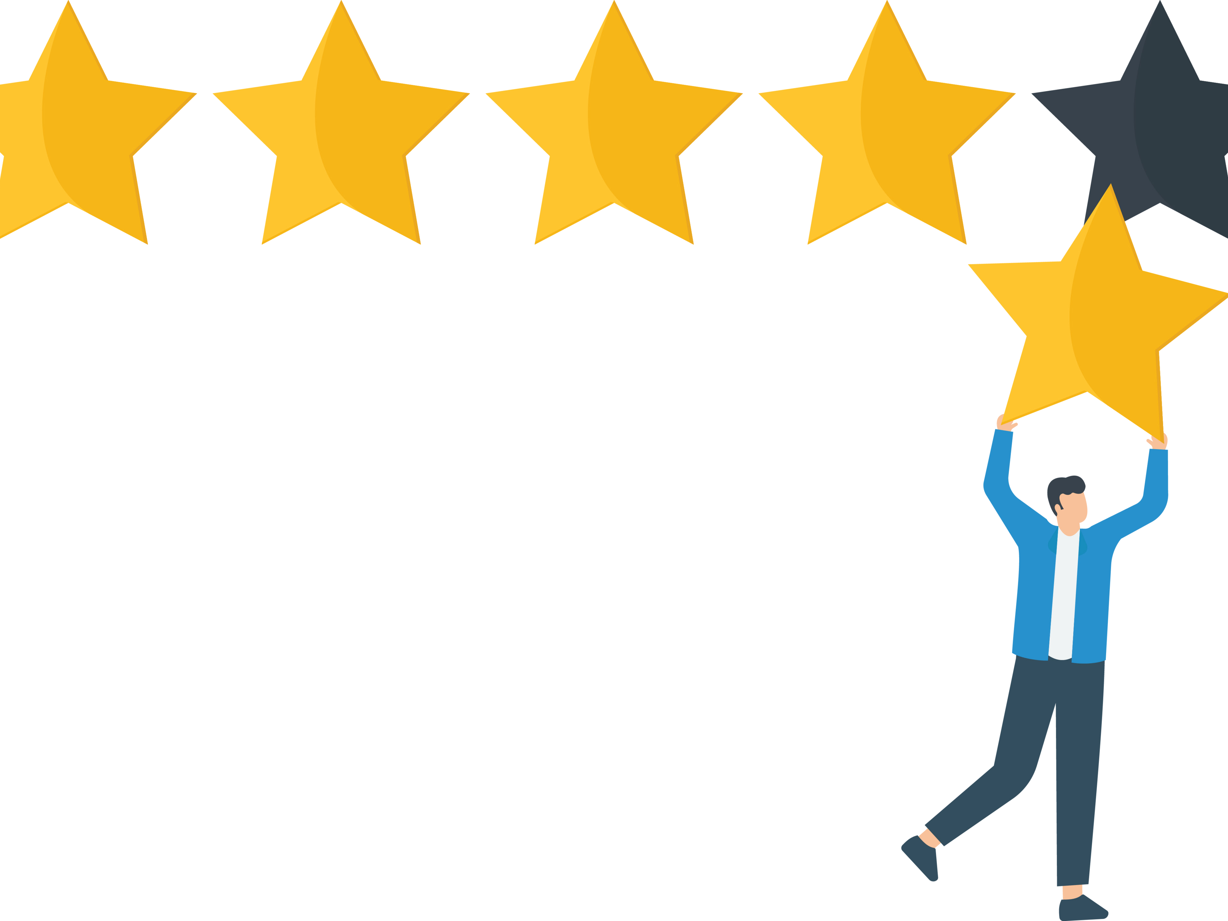
THANK YOU
Project Sponsor: ABC Enterprises, LTD
Project Manager: Ram Kumar

