Slide 1
Digital Marketing Campaigning Optimization Platform
AI-driven platform to raise ROAS and lower CPA across channels
Developed By Nikhil Mali (Business Analyst) Date: 20/08/2025

Slide 2
The Challenge
Fragmented Channels (Situation)
Google, Meta, TikTok and other platforms create siloed data that's difficult to analyze holistically
Rising Ad Costs (Problem)
Inefficient spend leading to poor ROI across marketing campaigns
Opportunity
Create a unified AI platform to automate optimization and eliminate waste.

Slide 3

Purpose & Goals
Our Purpose
Build an AI platform that centralizes data, automates bids/creative tests, and surfaces actionable insights
Our Goals
Increase ROI across marketing channels
Reduce Cost Per Acquisition (CPA)
Boost team productivity
Enable truly data-driven decisions

Slide 4
Project Objectives
01
02
Integrate Data Pipelines
Develop ML Models
Connect multiple data sources including ads platforms, CRM systems, and analytics tools
Create predictive bidding, budget allocation, and lead scoring algorithms
03
04
Build Real-time Dashboard
Run Controlled Pilot
Develop interface with KPIs and automated alerts
A/B test against baseline campaigns to validate performance
05
06
Train & Document
Iterate & Scale
Create comprehensive playbook and train users
Refine based on pilot results before full deployment

Slide 5



Success Criteria & KPIs
30%
20%
ROI Improvement
CPA Reduction
Target +20–30% within 9 months of implementation
Target −20% within 9 months of implementation
15%
80%
Conversion Rate Lift
Dashboard Adoption
Target +15% in 6 months
≥80% of campaign managers actively using within 30 days
Model forecast accuracy: acceptable error thresholds to be defined during pilot phase

Slide 6
Methods/Approach
Why Agile (short):
• Iterative learning for ML & ad experiments adapt as models and data evolve
• Early, measurable value via pilot sprints lower risk & faster ROI
Stakeholder analysis & engagement methods:
• Stakeholder mapping & RACI matrix
• Persona workshops, stakeholder interviews & alignment workshops
Requirement gathering & prioritization:
• Discovery workshops, user interviews, analytics review
• Capture requirements as user stories with acceptance criteria
Roles & ceremonies:
• Product Owner, Scrum Master, PM, Data/ML Eng, Dev, QA, DevOps
• Sprint planning, daily standups, refinement, sprint review & retro
Recommended Tools & Tech:
• Project: Jira/Azure Boards; Docs: Confluence/Notion; Workshops: Miro
• Code/CI: GitHub/GitLab, CI (GitHub Actions/Jenkins); Docker & K8s
• Data/ML: Airflow/dbt, BigQuery/Redshift, MLflow/Kubeflow
• Cloud: AWS/GCP/Azure; BI: PowerBI/Looker; Observability: Grafana/Datadog
• Experimentation: LaunchDarkly/Split; Data quality: Great Expectations

Slide 7
My Role
Project Start / Discovery (Month1) • Stakeholder interviews & discovery workshops — capture personas & KPIs. • Create initial backlog & baselines (ROI, CPA, CVR).
Design & Requirements (M1–M2) • Convert needs into prioritized user stories (WSJF/Impact-Effort). • Validate wireframes; define data & integration points.
Data & ML Dev (M3–M4) • Validate data, create data dictionary, enforce quality rules. • Define model success criteria; build/test models & backtests.
Platform Build (M4–M5) • Build dashboard & reporting flows; refine UX stories. • Coordinate Dev/QA for UAT and sprint deliveries.
Pilot & Testing (M6) • Run control vs treatment pilot; monitor KPIs daily. • Collect feedback, fix priority issues, validate ROI/CPA.
Deployment, Training & Rollout (M7+) • Deliver training, run onboarding, publish runbooks. • Manage cutover, security approvals, measure adoption.
Ongoing Ops & Optimization • Groom backlog, monitor KPIs, schedule model retrains. • Monthly stakeholder reviews; vendor & compliance management.
Key Deliverables I Own • Personas, prioritized backlog, data dictionary, model cards. • Pilot report (ROI/CPA), training materials, runbooks.
Tools & Communication • Jira / Confluence / Miro; GitHub + CI/CD; Docker/K8s. • Airflow/dbt + BigQuery/Redshift + MLflow; PowerBI/Looker; Grafana. • Cadence: daily standup, weekly sponsor update, monthly steering.

Slide 8
Required Resources & Budget Estimate
Core Team (6–8 months)
1 Project Manager
2 Data Engineers
2 Frontend &Backend Developer
1 Marketing Lead
1 QA Specialist
1 Integration Consultant
Tools & Infrastructure
Cloud infrastructure (AWS/GCP/Azure)
Data warehousing
ML compute resources
Analytics tool licenses
API connectors
Business Intelligence tools
Timeline: 6–8 months to pilot and initial rollout

Slide 9
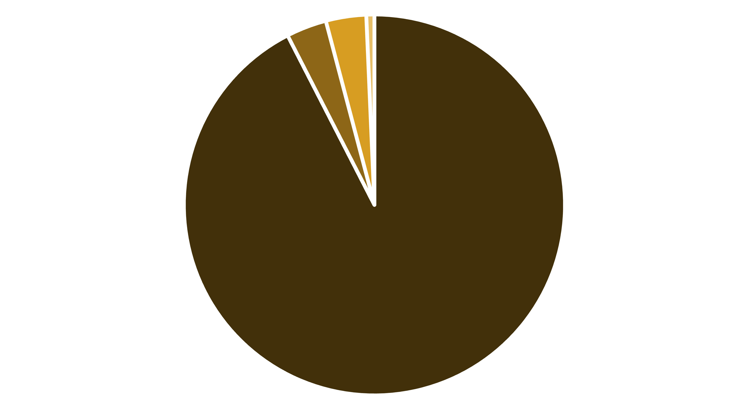
Budget Summary
Personnel (6–8 months)
Cloud & tools
Pilot ad testing
Training & misc.
Total: ₹29,20,000 (~₹30 Lakh)
Add 10% contingency if needed
Pilot Estimate (INR)

Slide 10
Risks & Mitigations
Data Access & Quality
Model Underperformance
Low Adoption
ML models may not deliver expected results initially
Team resistance to new platform and workflows
Risk of incomplete or poor-quality data from various platforms
Mitigation: Start with simple models, validate thoroughly, iterate based on feedback
Mitigation: Early demos, comprehensive training, user feedback incorporation
Mitigation: Implement validation protocols and fallback data exports
Integration Delays
Budget Risk
Potential delays with APIs/CRM integrations
Potential for cost overruns during development
Mitigation: Plan buffer time, secure vendor support commitments
Mitigation: Establish clear pilot success gates before scaling

Slide 11
Project Timeline
Phase 1 (M1–M2)
1
Discovery, requirements gathering, architecture planning
2
Phase 2 (M3–M4)
Data ingestion + ML model development
Phase 3 (M4–M5)
3
Platform build & dashboard development
4
Phase 4 (M6)
Pilot launch & A/B testing
Phase 5 (M7+)
5
Training, rollout, continuous iteration

Slide 12

Conclusion & Call to Action
Recap
AI platform to improve ROAS across channels
Reduce CPA through intelligent optimisation
Centralise insights for better decision-making
Request
Approve Phase-1 pilot budget of ₹29.2 Lakh and sponsor sign-off
Next Steps
Finalise team, secure data access approvals, begin kickoff workshops in 2 weeks
Long-term Vision Transform marketing operations from fragmented manual processes to integrated, AI-driven optimization.
Project Contacts: Project Sponsor Akash More, Project Manager Prashant Thakkar, Business Analyst: Nikhil Mali

