Slide 1
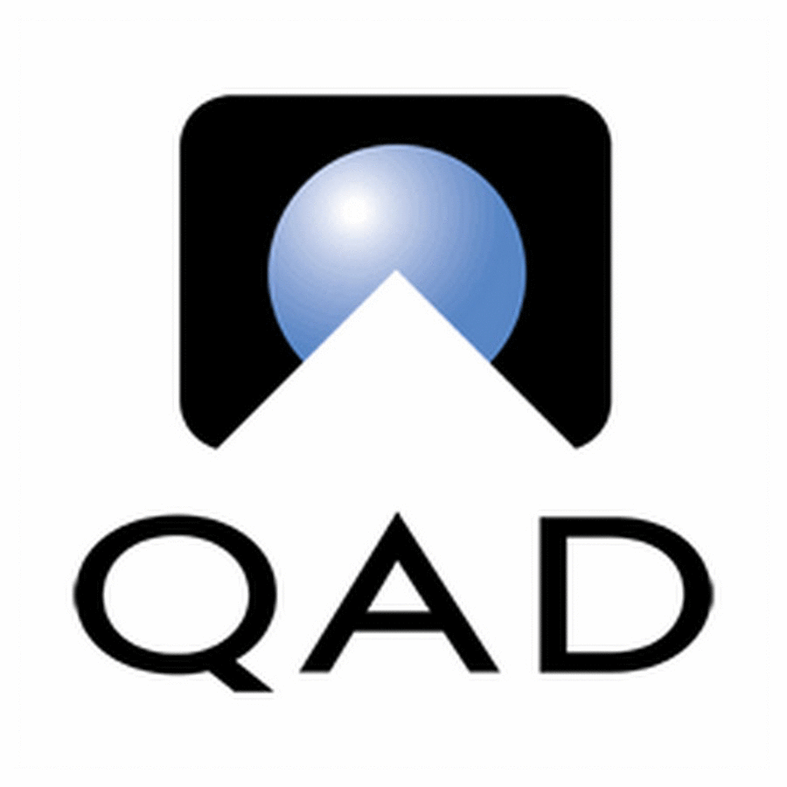
QAD Enhancement
Rashmi Garse

Slide 2
Situation
Slow US QAD Data Retrieval: Retrieving data from the US-based QAD system is significantly slower compared to EU systems, leading to frequent timeout errors during the night run.
Stored Procedure Not Fetching Data: The stored procedure using a preselectquerybatch for fetching 2022 data from QAD is not retrieving any records, with the exception of the ac_mstr table.
Pipeline Running Without Data Transfer: The pipeline runs for over 30 minutes without successfully reading or writing any data from the QAD system, resulting in no data being processed.
Failure in Data Transfer for Most Tables: While data is retrieved from the ac_mstr table, other QAD tables continuously run without transferring any data, causing delays and stalling the process.

Slide 3
Problems
Slow Performance: Data retrieval, especially from remote locations, is often slow, causing delays.
Complex Integration: Integration with other systems is challenging, leading to synchronization issues.
Limited Scalability: QAD struggles to scale, causing performance bottlenecks as business grows.
Cumbersome User Interface: The interface is difficult to navigate, reducing user efficiency.
Data Inconsistencies: Issues with data retrieval and transfer lead to incomplete records.
Lack of Flexibility: Customization for specific needs is time-consuming and difficult.
Support Challenges: Ongoing maintenance can be resource-heavy, with slow vendor support.

Slide 4
Opportunities
Optimize Data Retrieval: Implement caching mechanisms or consider using more efficient query structures to speed up data retrieval, especially for remote locations.
Improve Integration Tools: Invest in advanced integration platforms or middleware that can simplify and automate the connection between QAD and other systems, improving data synchronization.
Cloud Migration: Transition to a cloud-based solution to improve scalability, performance, and reduce maintenance overheads.
User Interface Revamp: Redesign the user interface for better usability and a more intuitive experience, reducing the learning curve for users.
Data Quality Management: Implement automated data validation and error-checking processes to ensure data consistency and integrity across systems.
Customization with Modern Tools: Leverage modern tools or APIs to make customizations easier and faster, reducing the complexity of adapting the system to business needs.
Enhanced Support: Partner with the vendor for better support or explore third-party managed services to ensure timely issue resolution and minimize downtime.
Regular System Audits and Upgrades: Conduct regular audits and updates to the system to ensure it runs efficiently, and identify and fix performance issues proactively.

Slide 5
Purpose Statement (Goals):
Optimize Data Retrieval: Implement caching and optimize query structures to speed up data retrieval, particularly from remote locations, and reduce timeout errors.
Improve Integration Tools: Invest in middleware or integration platforms to automate and simplify data synchronization between QAD and other systems, enhancing operational efficiency.
Cloud Migration: Transition QAD to a cloud-based solution for improved scalability, performance, and reduced maintenance overhead, ensuring better resource management.
User Interface Revamp: Redesign the QAD interface to be more intuitive and user-friendly, reducing the learning curve and enhancing user productivity.
Data Quality Management: Implement automated data validation and error-checking processes to ensure consistent and accurate data across systems, improving overall system reliability.

Slide 6
Project Objectives:
Enhance Data Retrieval Performance
Streamline System Integration
Facilitate Cloud Transition
Improve User Experience
Ensure Data Consistency and Accuracy
Simplify Customization
Improve Support and Maintenance
Ensure System Optimization

Slide 7
Success Criteria
Improved Data Retrieval Speed: Reduction in data retrieval time, with no timeout errors, especially from remote locations.
Seamless System Integration: Successful real-time data synchronization between QAD and other systems without manual intervention.
Successful Cloud Migration: QAD operates effectively in the cloud with improved scalability and performance, with minimal downtime during the transition.
User Interface Usability: Increased user satisfaction and reduced training time due to a more intuitive and user-friendly interface.
Data Accuracy: Consistent and accurate data across systems, with fewer data inconsistencies and errors.
Efficient Customization: Faster and easier customizations made to QAD, meeting specific business needs without significant delays.
Timely Issue Resolution: Faster resolution of issues through enhanced vendor support or third-party managed services.

Slide 8
Methods/Approach:
Agile Methodology

Slide 9
Methods/Approach:
Agile Methodology is an iterative project management approach that focuses on delivering small, incremental improvements through regular feedback and testing. It’s ideal for projects with evolving requirements, allowing teams to adapt quickly and efficiently.
In this case, Agile is beneficial because:
Frequent Feedback: Continuous reviews ensure that issues like data retrieval, integration, and UI improvements are addressed promptly.
Flexibility: Agile allows for rapid adjustments as new challenges arise, keeping the project aligned with business goals.
Incremental Delivery: Improvements are delivered in small, manageable chunks, reducing risk and ensuring stability.
Stakeholder Involvement: Regular collaboration with stakeholders ensures the solution meets user needs effectively.

Slide 10
Methods/Approach:
Establish Project Team and Define Objectives: Assemble a cross-functional team and clearly define project goals and success criteria.
Conduct Sprint Planning and Prioritize Features: Break down the project into sprints, prioritize tasks such as data retrieval optimization, UI redesign, and cloud migration based on business needs.
Iterative Solution Design and Development: Develop and implement improvements in short iterations, regularly reviewing progress with stakeholders and adjusting based on feedback.
Test and Validate in Each Sprint: Conduct testing after each sprint to ensure features are meeting requirements, such as validating data retrieval speed and UI usability.
Continuous Integration and Deployment: Use CI/CD pipelines for seamless updates and integrations, ensuring that all components work together effectively as the system evolves.
Regular Reviews and Adjustments: Hold sprint review meetings to gather feedback, assess progress, and refine the solution to meet evolving requirements and challenges.

Slide 11
Approach
We will use Scrum model or iterative approach to complete the project.
Scrum model will help us to achieve the objective in which each iteration/sprint will deliver some clearly visible module migration
Meetings involved in this process are Project Kick-off, Sprint Planning, Daily Scrum, Backlog Refinement, Sprint Review, Sprint Retrospective, Repeat Daily Scrums, Final Retrospective
Few consultation with SME with respect to regulations and guidelines needs to be done.

Slide 12
Resources:
People
  Project Sponsor: Devendra Chaudhari
  Project Manager : Rashmi Garse
  Developers : Rudransh, Tweesha, Moksh, Ishika, Laksh and Ishani
  Testers: Shobha and Pramod
  Network Admin: Dhaval

Slide 13
Resources:
Time
  Project to be completed in 12 Months time span
Budget
  Budget allotted is 2 Cr.
Software and Hardware (Not to exceeded. 50 lacs)
  Latest Version of JAVA for App development and testing
  Laptops
  Firewalls and VPNs to protect Data
  Wi-Fi, Router installation and maintenance

Slide 14
Risks and Dependencies:
Integration Challenges: Dependencies on third-party systems or legacy applications may cause delays if integration points are not well-defined or compatible with Agile iterations.
Data Migration Complexity: Migrating data to the cloud or optimizing data retrieval can be complex and dependent on the availability and accuracy of existing data, potentially causing delays.
Vendor Reliability: Dependency on QAD vendors or third-party service providers for support, updates, or customizations may lead to delays if the vendor does not meet deadlines or quality standards.
Testing Bottlenecks: Agile focuses on continuous testing, but limited resources or complex testing scenarios (e.g., data validation, system integrations) can create bottlenecks and delay sprints.
Cloud Transition Risks: Transitioning QAD to the cloud could face unexpected compatibility or performance issues, especially during early iterations, delaying full deployment.

