Slide 1
WAREHOUSE MANAGEMENT SYSTEM
5FTC1214
PROJECT MANAGEMENT AND PRODUCT DEVELOPMENT GROUP EEE

Slide 2
LITERATURE SURVEY
Types of WMS
Standalone – A standalone warehouse management system is your typical on premises type system which is deployed on the native hardware and network of the business. These systems are often the lowest long-term cost option, but lack the benefits of a more integrated WMS option.
2. ERP Modules –Some ERP vendors, such as IQMS, offer a warehouse management system that is built into their ERP solution. This type of solution provides embedded EDI, accounting, sales orders, MRP and shipping management with no messy non-real time interfaces.

Slide 3
LITERATURE SURVEY
3. Cloud Based – A cloud warehouse management system is a web-based software as a service (SaaS) model utilizing enterprise cloud technology. The benefits of cloud-based WMS software include better flexibility, disaster recovery, scalability, and security.

Slide 4
Features of WMS
LITERATURE SURVEY
Warehouse design: Includes the design and bin slotting that maximizes the storage space
2. Inventory tracking: Use of advanced tracking systems, such as RFID,AIDC and barcode scanners to make sure that goods can be found easily when they need to move
3. Receiving and put away: Allows inventory put away and retrieval, help workers locate goods
4. Picking and packing goods: Including zone picking, wave picking, and batch picking etc.

Slide 5
LITERATURE SURVEY
5. Yard and dock management: Assists truck drivers to find the right loading docks
6. Reporting: Helps to analyze the performance of warehouse operations and find areas to improve
7. Shipping: Enables the WMS to send bills-of-lading, generate packing lists and invoices for the shipment and send advance shipment notifications to recipients.
8. Labor management: Helps to monitor workers' performance by using key performance indicators

Slide 6
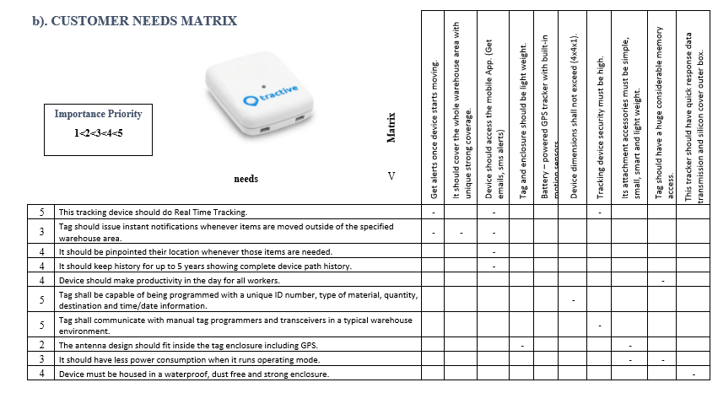
NEEDS v MATRICS

Slide 7
MISSION STATEMENT
Product Description
Warehouse management system for organizations which can prevent theft, non-utilization of stored items while maximizing the warehouse functions to improve business productivity
Benefit Propositions
Warehouse design
Inventory tracking (RFID, Barcode)
Receiving and put away
Picking and packing goods
Labor management
Reporting

Slide 8
MISSION STATEMENT
To provide excellent solutions for Tracking and Asset/Inventory Management problems by assigning a detailed label containing weight, dimensions, barcode stickers and many others.
To maintain a safe and secure business/work environment. Innovate the way to achieve sustainability, efficiency, growth and profits.
To help store/organize the products and get them back more efficiently and effectively by assigning individual location number which also contains details about storage type, size and location.
Reduce/minimize theft of stocks by integrating a biometrics-controlled access system and 360° surveillance camera running 24/7.

Slide 9
MISSION STATEMENT
Helps to increase productivity by controlling, monitoring and managing the warehouse operations centrally and also by using a hand-held device without needing to pay individual attentions to each operation.
Provides a fully detailed report on each day’s operations/task which consist of almost everything like daily incoming and/or outgoing products, delivery deadlines, storage space utilized and many more.
Provides customized storage spaces based on cargo/product type like frozen or perishable goods, items that requires special handling, inflammable/toxic products and many other types.
Monitor labor/workforce productivity centrally without the need of checking them individually or regular checkups.

Slide 10
QUALITY STANDARDS TO BE ADHERED
ISO 9000:2015 – Sets out criteria for Quality Management System (QMS) based on a number of quality management principles including a strong customer focus, motivation and implication of top management and other factors. (Fundamentals and Vocabulary)
• ISO 9004:2018 – Provided guidelines for enhancing an organization’s ability to achieve sustained success.
• ISO 9001 – ISO 9001 is defined as the international standard that specifies requirements for a quality management system (QMS). Organizations use the standard to demonstrate the ability to consistently provide products and services that meet customer and regulatory requirements

Slide 11
QUALITY STANDARDS TO BE ADHERED
• ISO 9002 – It is meant for those companies which handle processing or production, provided they did not deal with patenting or new products.
• ISO 9004 – Provides guidance for sustaining the success of an organization’s objectives.
• ISO 9001:2000 – Quality Management System
Management Responsibility

Slide 12
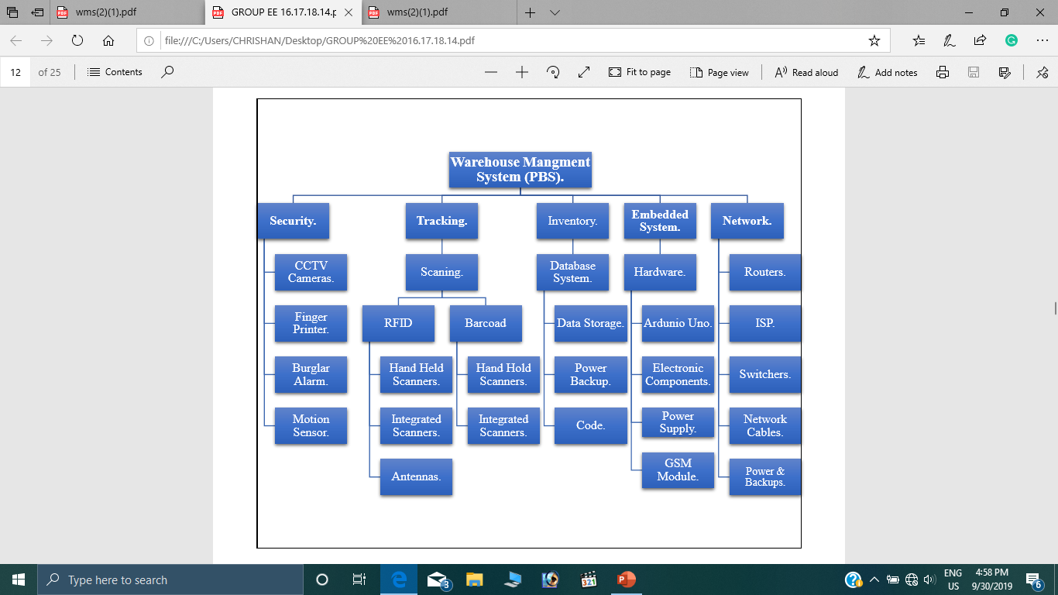
PRODUCT BREAKDOWN STRUCTURE

Slide 13
BUSINESS CASE
EXECUTIVE SUMMARY
A warehouse management system (WMS) is designed to control the movement and storage of materials within an operation and process the associated transactions. This tracking, along with the benefits of task interleaving, cross docking, and automatic data capture, can help consumer products companies improve their inventory management process to remain competitive.
REASON
The main purpose of introducing the Warehouse Management System (WMS) is to give a great support to the daily operations of a warehouse.

Slide 14
BUSINESS CASE
BUSINESS OPTION
large warehouses have been developed which is difficult to manage their processes. Warehouse management systems have been introduced and gain the spotlight in the industry to solve these problems

Slide 15
BUSINESS CASE
Expected benefits
• High customer relationship when purchasing goods.
• Any misplaced goods could be easily identified.
• High value of efficiency when purchasing goods.
• Classification of good of goods could be orderly saved in a database for easy identification.

Slide 16
BUSINESS CASE
Expected dis benefits
• Power source failure begin unable to track goods.
• Barcode reader saving insufficient information of the product.
• Goods classified disorderly into the database, marking the procedure insufficient.

Slide 17
BUSINESS CASE
TIMESCALE
The time scale for the complete project is given on the Activities and Time schedule, Gantt Chart and Network diagram of the WMS project development.
COSTS
The cost for the product manufacturing is represented in the is given the “Bill of Quantities”. The fixed cost and variable cost are depending on the scale of the warehouse management system.

Slide 18
BUSINESS CASE
RISK ANALYSIS
• New and unproven technologies.
• User and functional requirements are changing.
• Selecting the correct application and system architecture.
• Increasing need of high performance.
• Organizational Problems.
• Need to have a good communication between customer.
• Many Warehouse Management Systems are in the market which much more popular.

Slide 19
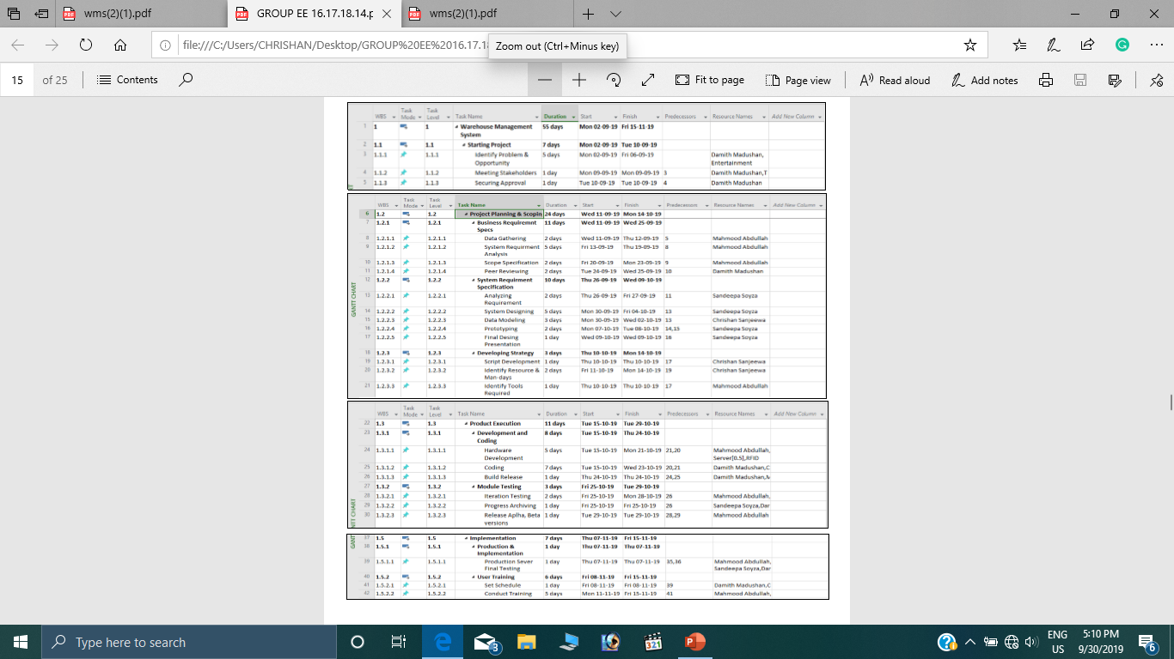
ACTIVITIES & TIME SCHEDULE

Slide 20
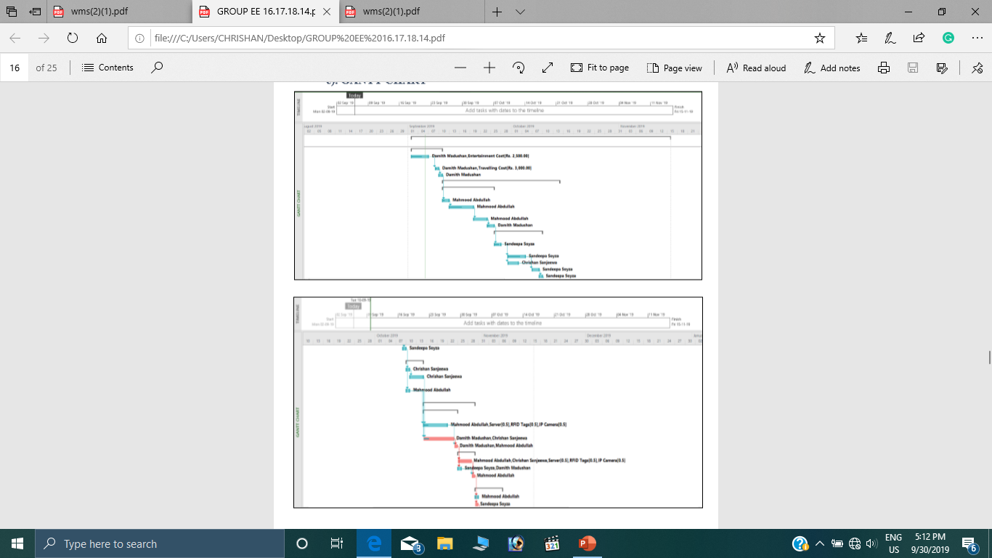
GANTT CHART

Slide 21
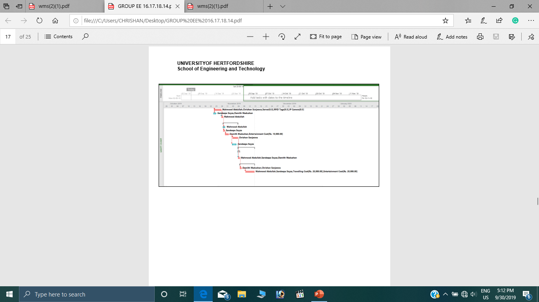
GANTT CHART

Slide 22
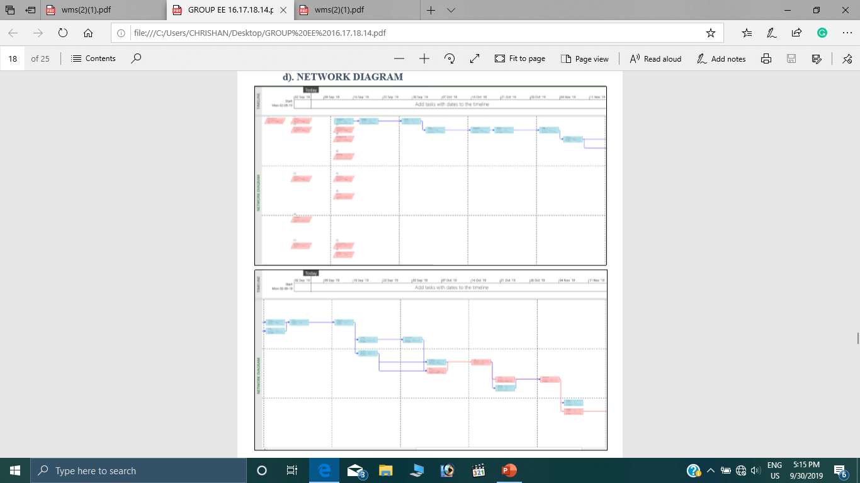
NETWORK DIAGRAM

Slide 23
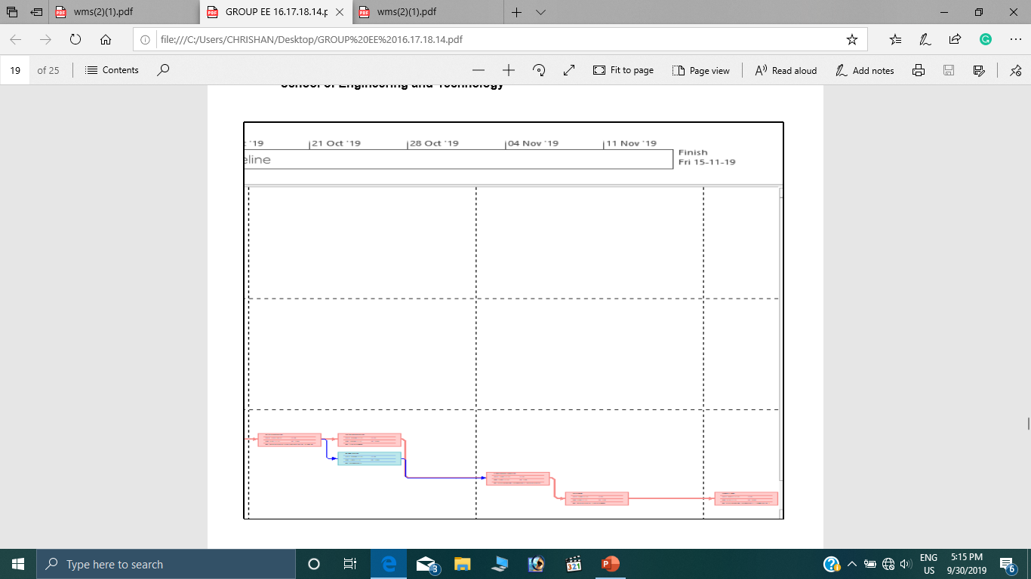
NETWORK DIAGRAM

Slide 24
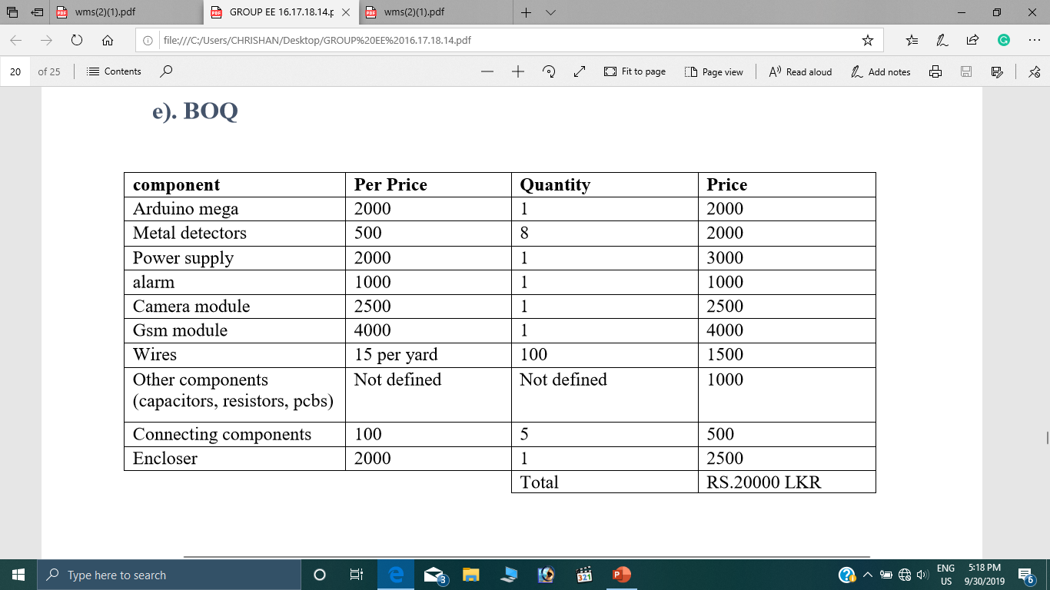
BILL OF QUANTITIES

Slide 25
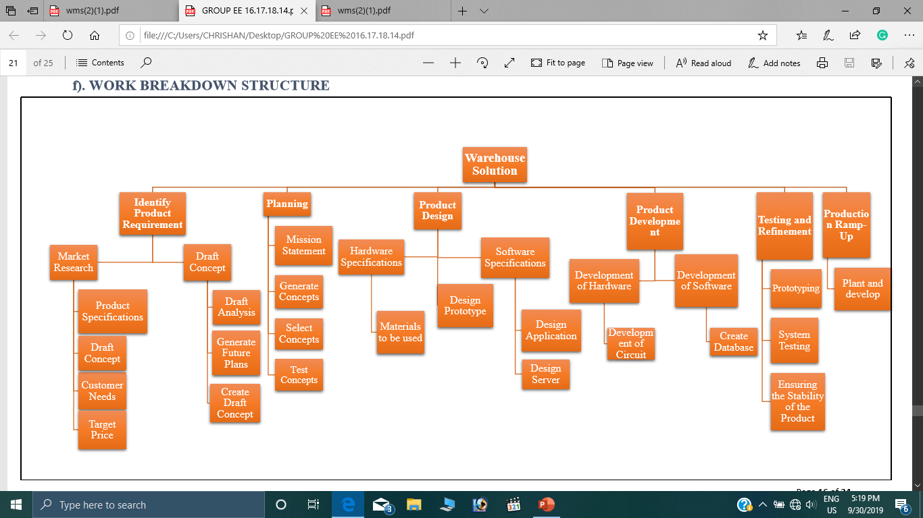
WORK BREAKDOWN STRUCTURE

Slide 26
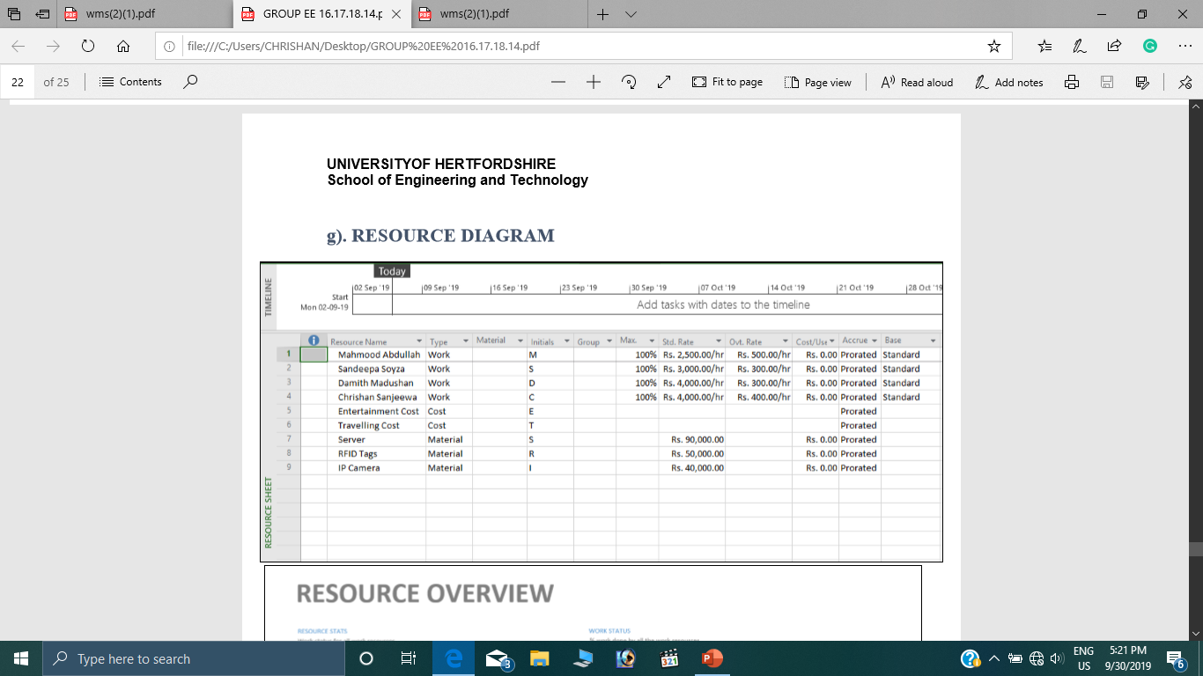
RESOURCE DIAGRAMS

Slide 27
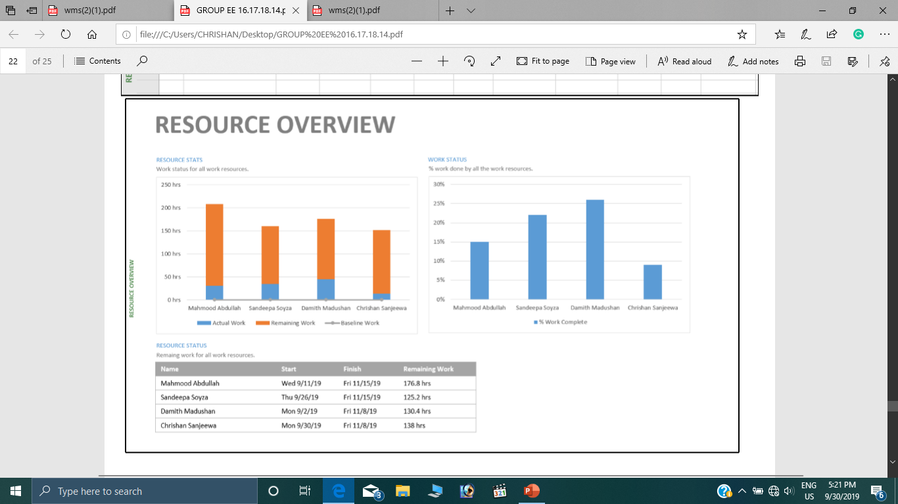
WORK OVERVIEW

Slide 28
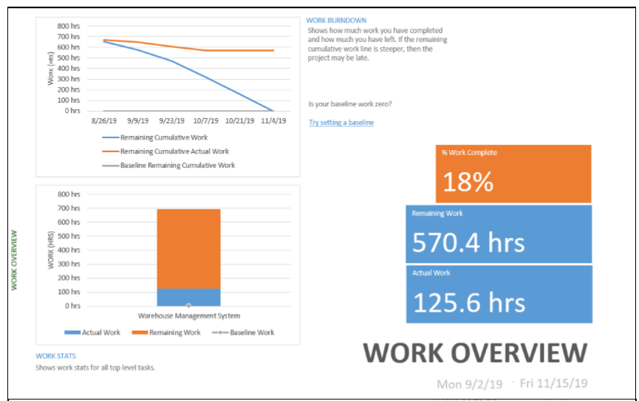
WORK OVERVIEW

Slide 29

WORK OVERVIEW

Slide 30
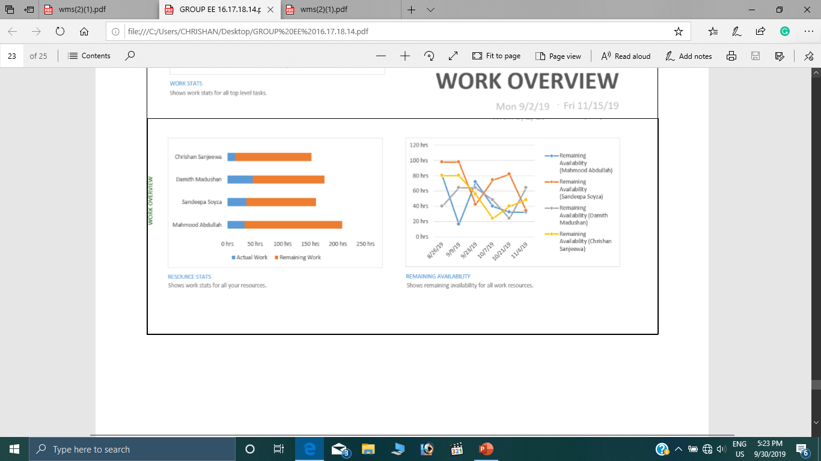
WORK OVERVIEW

Slide 31
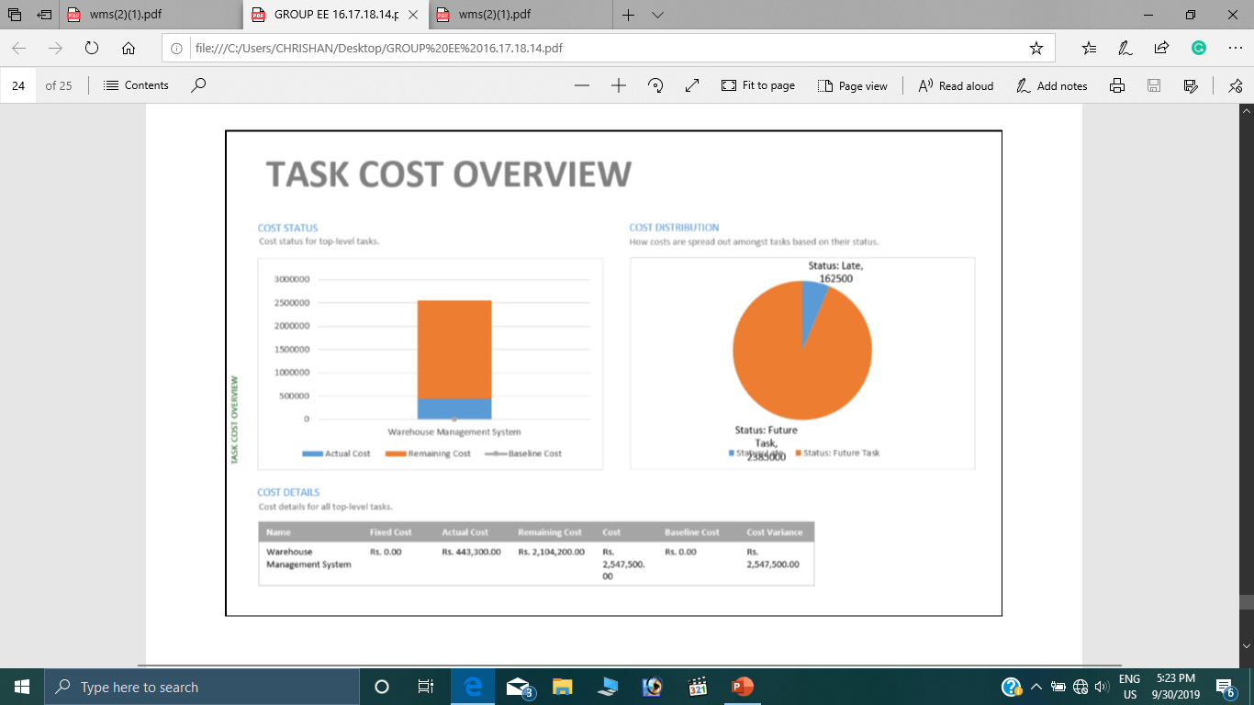
WORK OVERVIEW

Slide 32
THANK YOU

