Slide 1

LIGHT AUTOMATION TOOL

Slide 2
Idea behind the project:
The motive behind this project was to understand the working of any payment engine and payment gateways. People have faith that their money is secured. This faith is turned into curiosity to know about the system behind it.
Business Goals:
To build An Automated Payment Release tool which is very user friendly and can release bulk payments with 100% accuracy without manual intervention.
Problem with existing system:
i)Need more time for the payment processing as all the transactions are done manually.
ii)More resource is required to finish Bulk Payments.
iii)Lack of resource cause extra burden for the team.
iv) Cut off missed
v) SLA not met
v) Unfinished work is overloaded
vi) Extra working hours needed
vii) The chances of error much high and reduce the overall productivity.

Slide 3

PROJECT OBJECTIVES
The objective of the proposed system is to reduce the manpower requirement and release bulk payment in less time with a 100% accuracy.
The primary and main objective of the tool is to simplify the Bulk Payment release.
It picks correct customer reference id, identify correct customer name, payment release date and draft mail to RM to notify about the payment action taken.
The management can easily get data for future reference.

Slide 4

Inputs:
User Research: Document analysis helped to verify existing procedure ,Brain Stroming Helped to generate ideas for payment release methods.
Interviews with operators,Stakeholders,Project managers helped to understand the project requirements, Stakeholders requirements and goals for the project.
RESOURCES REQUIRED: Computers, Internet connectivity, LAN connections, Outlook Mailbox.

Slide 5

Stakeholder Identification:
Project Manager: Odette Boire
Developer: Konad
Support: Andrew Joseph
QA: Nadine Ahamed
BA: Piyali Chaudhuri
Timeline:1.5 Months.

Slide 6
Feasibility study:
ECONOMIC FEASIBILITY: The cost of developing this project is merely the man hours that are put into it on the institutional front the cost that it will be bearing is to comply with the minimum system requirements for the same.
METHODS: Once the payment is received in Authorizations Exceptions queue due to insufficient Funds the system performs the check for funds on the account only once before works get start or just after receiving the payment in the system. This control is being repeated regularly during the day and if the meantime the account is sufficiently funded the transaction is automatically released by the system.
Still there is also a manual “Rechecking’’ option available from the drop down in each payment blocked in Insufficient Funds

Slide 7
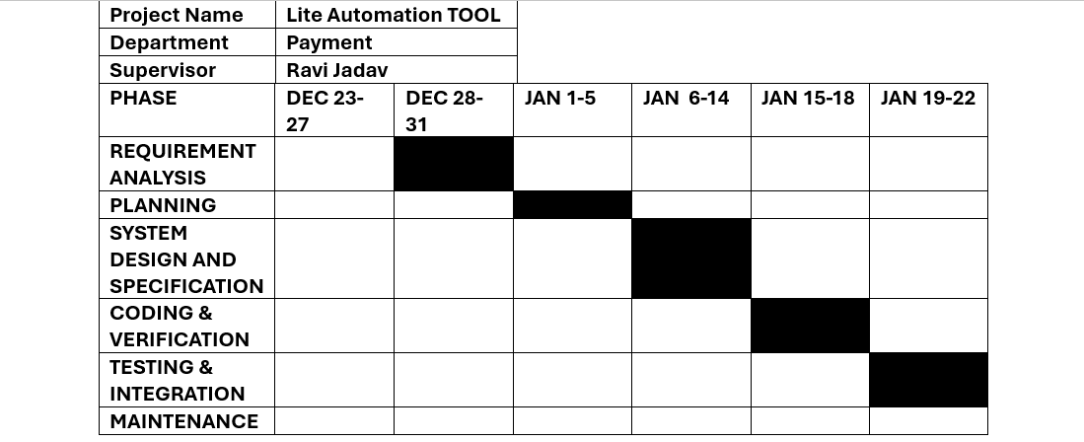
Project duration:

Slide 8
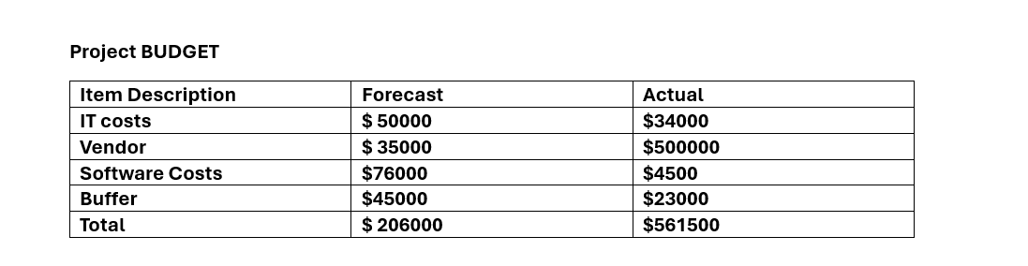

Slide 9
Role of a Payment Automation Tool:
This automated Payment Tool is used to accept, validate, authenticate, sort, direct, clear and settle payment transactions received from a diverse range of originating systems and deliver these payments, on the appropriate date or time, to an equally diverse range of destination systems. This Payment Tool does Global Funds Verification(Global Deck) , check restriction control and navigate between different applications, draft mails, update comments.

Slide 10
Risk Analysis:
Automation Tool can leads to job losses.
Automated Systems can reduce human interaction in customer service
If tool stops working the back up resource has to be ready for the day which may cause overload of work

Slide 11
TECHNICAL BACKGROUND
In this project the tool is developed by using JAVA, HTML and CSS. Google Chrome is used for display. Hyper-Text Markup Language (HTML) is the standard language of the Internet. Java is an object oriented programming language which is widely used as back end development projects. In addition, Google Chrome is a browser used for web part.
Database: Design a secure database system for storing transaction and customer data, possibly using a combination of relational (e.g., PostgreSQL) and NoSQL (e.g., MongoDB) databases.
APIs: Develop RESTful APIs with clear documentation (e.g., using Swagger) for easy integration into merchant platforms

Slide 12
Customer Experience
1) Low cost of operations
2) Improvement in customer services
3) Efficiency in funds management
4) Improved fraud detection
5) Higher security

