Slide 1

BA Job Market - Awareness Session
Valid till 31 Dec 2024
Mission To Provide People With Opportunities To Build a Better Future
COEPD BA Job Market (BJM) Platform - Guidelines to follow
NOTE :
This document is valid until the next change.
(or)
till 31 Dec 2024.
For the latest document, please refer document No: 35 in the document section of the portal.

Slide 2
BA Job Market - Awareness Session
Valid till 31 Dec 2024
BJM Platform Overview
1. BJM Introduction
2. BJM Platform Registration
3. BJM Regular Activity
4. BJM Special Activity
5. BJM Service Requests & Escalations
6. BJM Remedial Work - Challenges
7. BJM Platform Guidelines
1. BJM Introduction
Slide 1/6

Slide 3
BA Job Market - Awareness Session
Valid till 31 Dec 2024
Thoughts to build Professionalism
Student should behave professionally.
BA openings are requirements of the respective companies,once the company initiates these openings then only we can apply for these openings,COEPD will not generate any jobs,COEPD will guide the students about these openings available in the market.
Student should NOT get into any arguments or conflicts with the facilitating Staff.
1. BJM Introduction
Slide 2/6

Slide 4
BA Job Market - Awareness Session
Valid till 31 Dec 2024
BJM Platform Checklist
Refine keywords in Resume
Apply for Jobs
Updating Progress in BJM Platform
BJM Service Requests & Escalations
Shortlisting
Interview Schedule
FAQs
Interview Support
Job Offers
Joining in BA role
BJM Remedial Work - Challenges
BJM Platform Guidelines
Datasheet
PROFILE Owner
BJM Awareness Sessions
HR Mocks
Do SWOT on BA Job Market
Identify Suitable Jobs
1. BJM Introduction
Slide 3/6

Slide 5
BA Job Market - Awareness Session
Valid till 31 Dec 2024
BJM Platform Registration
2.1. Data Sheet
2.2. Profile Owner
2.3. BJM Awareness Sessions
2.4. Session Attendance
2.5. HR Mock Interview
1. BJM Introduction
Slide 4/6

Slide 6
BA Job Market - Awareness Session
Valid till 31 Dec 2024
BJM Regular Activity
3.1. Do SWOT on BA Job Market
3.2. Identify Jobs
3.3. Finetune Resume
3.4. Apply for Jobs
3.5. Updating in BJM Platform
1. BJM Introduction
Slide 5/6

Slide 7
BA Job Market - Awareness Session
Valid till 31 Dec 2024
BJM Special Activity
4.1. Resume Shortlisting
4.2. Interview Schedule
4.3. FAQs Interview Questions
4.4. Interview Support
4.5. Job Offers
4.6. Joining in BA role
1. BJM Introduction
Slide 6/6

Slide 8
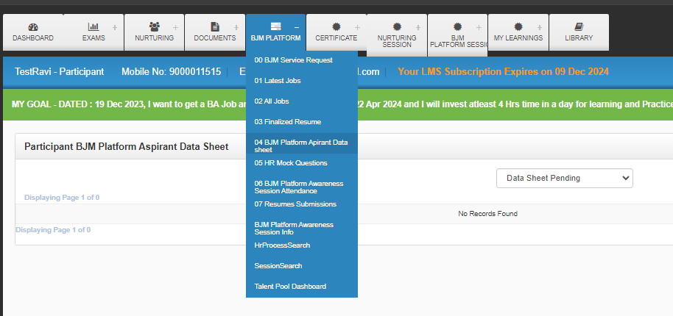
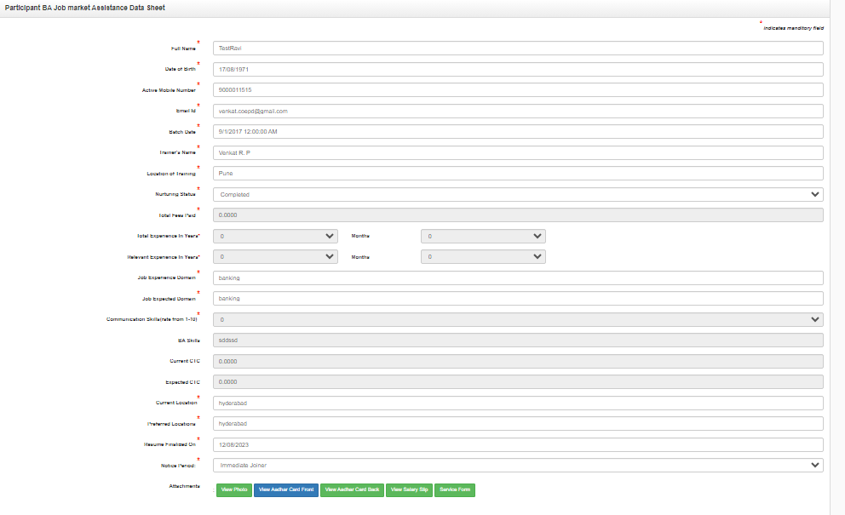
BA Job Market - Awareness Session
Valid till 31 Dec 2024
2.1.BJM Platform- Aspirant Data Sheet
Under the BJM Platform Tab, go to the BJM Platform Aspirant Data Sheet
Click On “Add New” enter all the details given in the Data Sheet and upload Passport size photo, Aadhar front &Back, Salary slip and BJM platform Service Form and Click on “Submit”.
2.2. Profile Owner
Profile Owner – SPOC
After Submitting the Data Sheet Profile owner(HR) will reach the participant and guide them to attend the BJM Platform Awareness Session
2. BJM Platform Registration
Slide 1/4

Slide 9
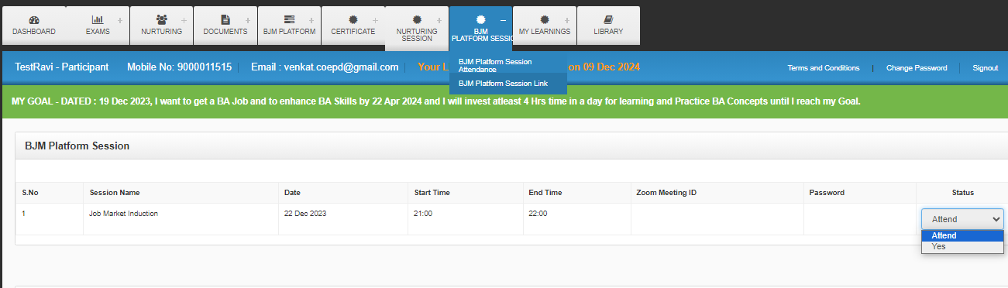
BA Job Market - Awareness Session
Valid till 31 Dec 2024
2.3.BJM Platform Awareness Session
Please attend BJM Platform Awareness Session, under BJM Platform Session, go to BJM Platform Session Link click on Attend and click on “Yes” you will get meeting id & password.
NOTE: BJM Platform Awareness Session will be conducted on every Wednesday at 9:00 pm.
2. BJM Platform Registration
Slide 2/4

Slide 10
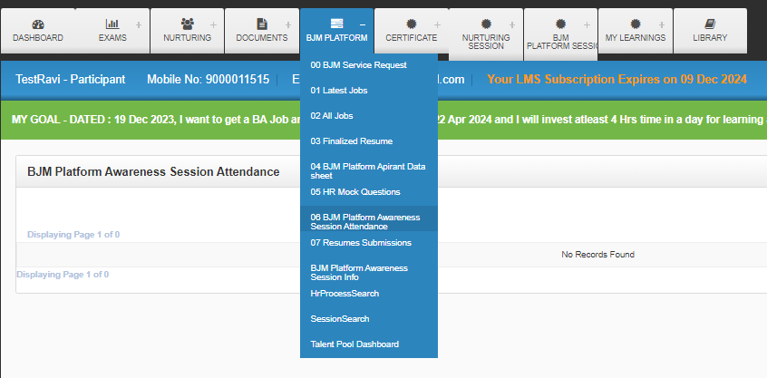
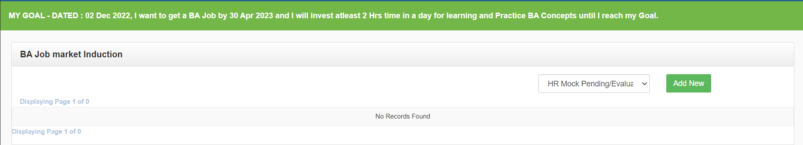
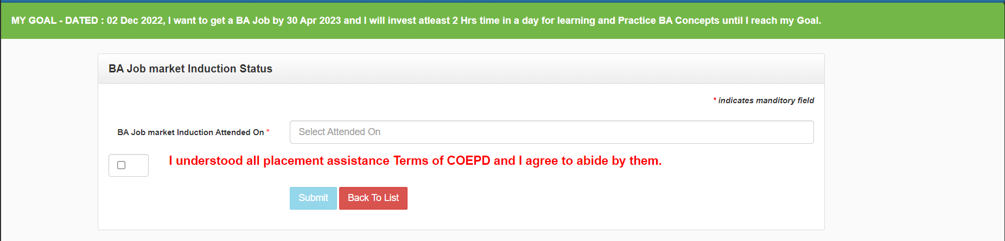
BA Job Market - Awareness Session
Valid till 31 Dec 2024
2.4.BJM Platform Awareness Session Attendance
After attending the BJM Platform Awareness Session, Under the BJM Platform Tab, go to the BJM Platform Awareness Session Attendance
Click on “Add New "Enter the BJM Platform session Attended date give Acknowledge and “Submit”.
2. BJM Platform Registration
Slide 3/4

Slide 11
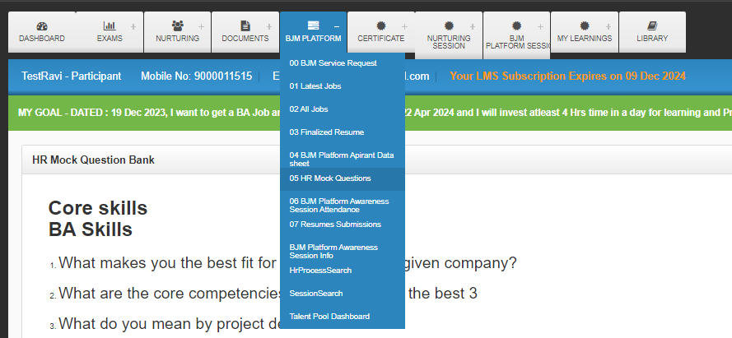
BA Job Market - Awareness Session
Valid till 31 Dec 2024
2.5.HR Mock Interview
After submitting the BJM Platform Session Attendance profile owner will reach the participant if not please raise the BJM service request and conduct the HR Mock
Before attending the HR Mock Aspirant should go through the sample Questions Under the BJM Platform Tab, go to the HR Mock Questions
Please attend HR Mock interview justify your knowledge on to your BA Resume Otherwise..
Redo will be given if Aspirant cannot justify his/her resume and Redoing mock interviews Redoing all projects(or)any other BA Assignment Given at the time
2. BJM Platform Registration
Slide 4/4

Slide 12
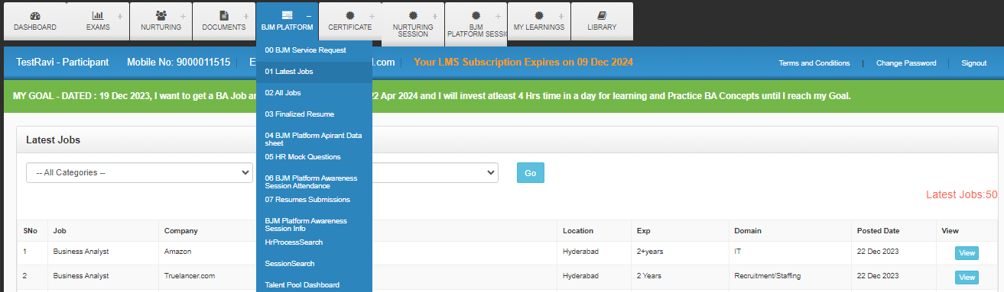
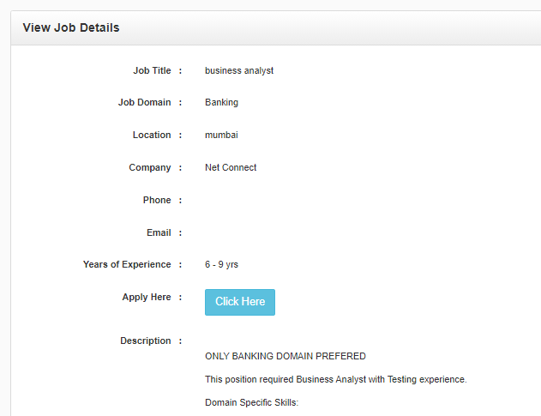
BA Job Market - Awareness Session
Valid till 31 Dec 2024
3.1.Do Swot On BA Job Market
Aspirant is starting BA career so set the right expectations on BA Job Market
3.2.Identify Suitable Jobs
3.3.Refine Keywords
3.4.Apply for jobs
Daily (Weekdays) Job Postings in COEPD Portal
  Aspirant should apply for these jobs through COEPD Portal
  COEPD Portal Under the BJM Platform Tab, go to Latest Jobs
  Click on “view”
  Study JD
  Identify Keywords-If possible, Add these keywords to your Resume and Apply click on “Click Here”
3. BJM Regular Activity
Slide 1/3

Slide 13
BA Job Market - Awareness Session
Valid till 31 Dec 2024
Apply Jobs from other Job Portals
  After clicking on “Click Here "it is re-directing to job portal website you can apply from company site.
  After applying for Jobs from COEPD Portal automatically updated in Resume Submissions Because it will be re-directing to the Resume Submissions as job applied
Job Portals (Linkedin,Naukri,Indeed..) -How to Apply
Study JD
Identify Keywords-If possible, Add these keywords to your Resume and Apply
Our BA Candidature (Resume) will be shortlisted, if we finetune the Resume as per the JD
Candidate should apply resume through job portals(Linkedin,Naukri,Indeed..) and references
3. BJM Regular Activity
Slide 2/3

Slide 14
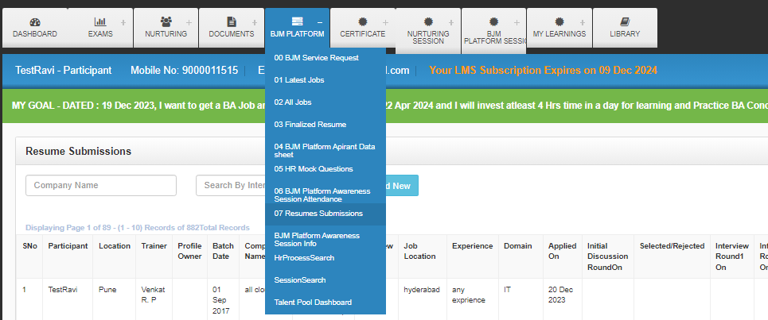
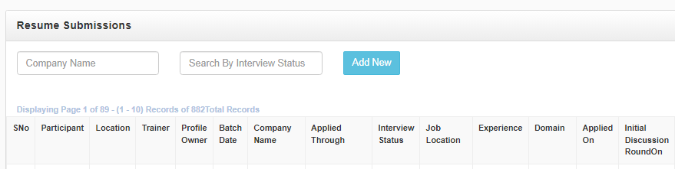
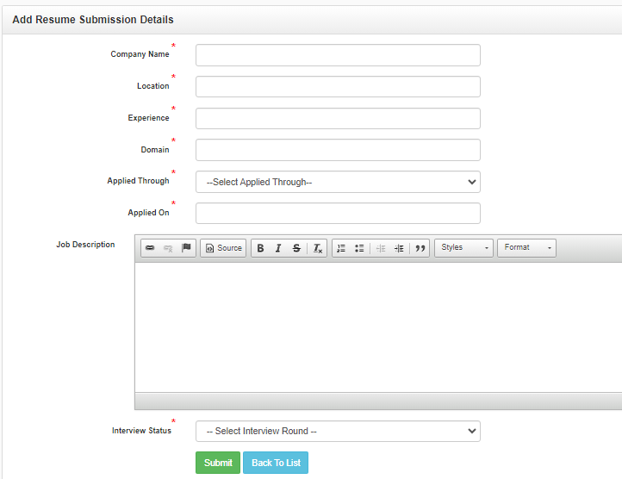
BA Job Market - Awareness Session
Valid till 31 Dec 2024
3.5.Updating Progress In BJM Platform Tab
Candidate should apply resume through Job Portals and References and update these submissions in COEPD Portal under the BJM Platform Tab, go to the Resume Submissions
Click on “Add New” enter the company details and “submit”
3. BJM Regular Activity
Slide 3/3

Slide 15
BA Job Market - Awareness Session
Valid till 31 Dec 2024
4.1.Shortlisted,
4.2.Interview Schedule
Our Alumni are working in 1000+ MNCs
Sharing Aspirant Resumes against JD of BA requirements of our Alumni references- if any
Sharing company interview FAQ’S for shortlisted candidates
For requesting FAQ’S and Interview Support the Aspirant should inform to the Team HR-Talent Pool at least 2 days earlier to the date of such interview.
Coordinating interviews if resume is shortlisted
Aspirant should be available for all interview Calls and Company Interactions
Sharing of interview Questions after the interview
COEPD Portal under the BJM Platform Tab, go to Resume Submissions ,Search by company name
4. BJM Special Activity
Slide 1/5

Slide 16
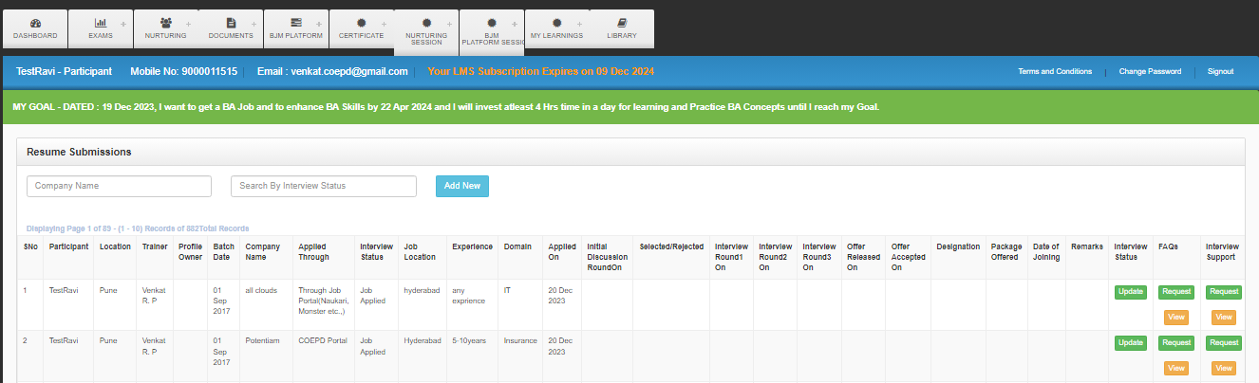
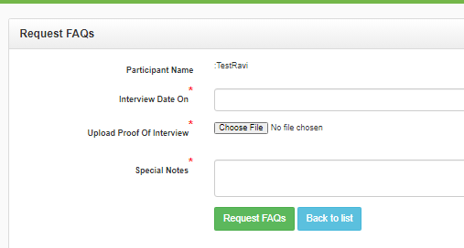
BA Job Market - Awareness Session
Valid till 31 Dec 2024
4.3.FAQ’s-Interview Questions
Move to the right side you will find FAQ Request “click on” Request, enter the interview date, upload proof of interview and enter skills and send FAQ Request.
After assigning the FAQ’S,FAQ Request below you will find “view "click on view and click on Action view then we are able to view the FAQ’S assigned by HR Team.
4. BJM Special Activity
Slide 2/5

Slide 17
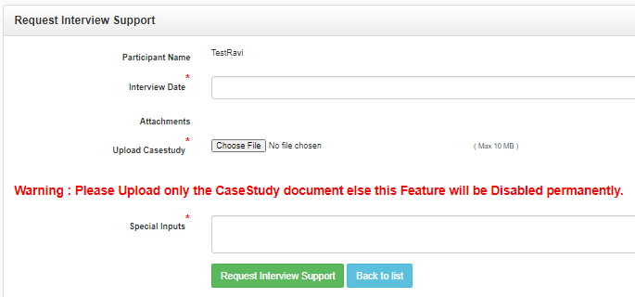
BA Job Market - Awareness Session
Valid till 31 Dec 2024
4.4.Interview Support
COEPD Portal under the BJM Platform Tab, go to Resume Submissions ,Search by company name
Move to the right side you will find Interview Support Request “click on” Request, enter the interview date, upload Case Study and enter skills and send Interview Support Request.
Interview support on the case studies, given in the interview, will be provided on request, to those Aspirant, who informs in writing to COEPD Team HR - Talent Pool, at least 2 days earlier to the date of such interview & We will guide you only after you work on case study
Mentors will provide Inputs, Tips and share required sample documents with the Aspirant for successful completion of interview.
Mentors will not prepare any documents for Aspirant which are given to them as a task in the part of interview. Mentors only guide the Aspirants for this purpose and Mentors will not prepare them at any cost.
4. BJM Special Activity
Slide 3/5

Slide 18
BA Job Market - Awareness Session
Valid till 31 Dec 2024
4.5.Job Offer
Any Job Offer with the then current market trends and suiting the Aspirant candidature. If Aspirant rejects the job offer citing other job offers, pay packs, location, company profile, projects, expectations, still this opportunity is a job offer and a job.
Nivxxxxx – 4 Job Offers
* 1st Offer *
Gemini - CTC: 13.5 LPA
* 2nd Offer *
Virtusa - CTC: 16 LPA
As Senior BA
* 3rd Offer *
EY - CTC:15 LPA
* 4th Offer *
Vodafone - CTC: 20 LPA
Business Analysis role with any designation (can be a new job through recruitment or role change in the current process of present job or additional responsibility of Business Analysis)
Job offer, after BA Training from COEPD, can be from any source (Aspirant/ Company/3rd party/ reference) is considered as Job offer secured through COEPD.
4. BJM Special Activity
Slide 4/5

Slide 19
BA Job Market - Awareness Session
Valid till 31 Dec 2024
4.6.Joining In BA Role
After getting into the role of BA, Share your Happiness through reviews on google n Social Media
Let’s help other BA Aspirants by spreading the good news about the BA Job and Aspirant will have no objection to use his/her name, photo and BA Job Company name journey, transcripts, scores, reattempts, interview feedback, and communication &concerning details for Workshop Promotion / COEPD Web portal/ Media promotions , Aspirant agree that COEPD is authorized to publish above Information.
Prior to enrolling in the training, you are not a BA. Underwent Nurturing introduced you to BA, and now we are undergoing BA training
I fully understand that BA is a new skill and opportunity, thus I agree to devote 100% of my time to learning and practicing BA. I will also follow COEPD guidelines, instructions, and regulations during my BA journey.
must register the details of his/her Job Offer with COEPD Portal before joining the company or need to fill the details once offer released.
4. BJM Special Activity
Slide 5/5

Slide 20
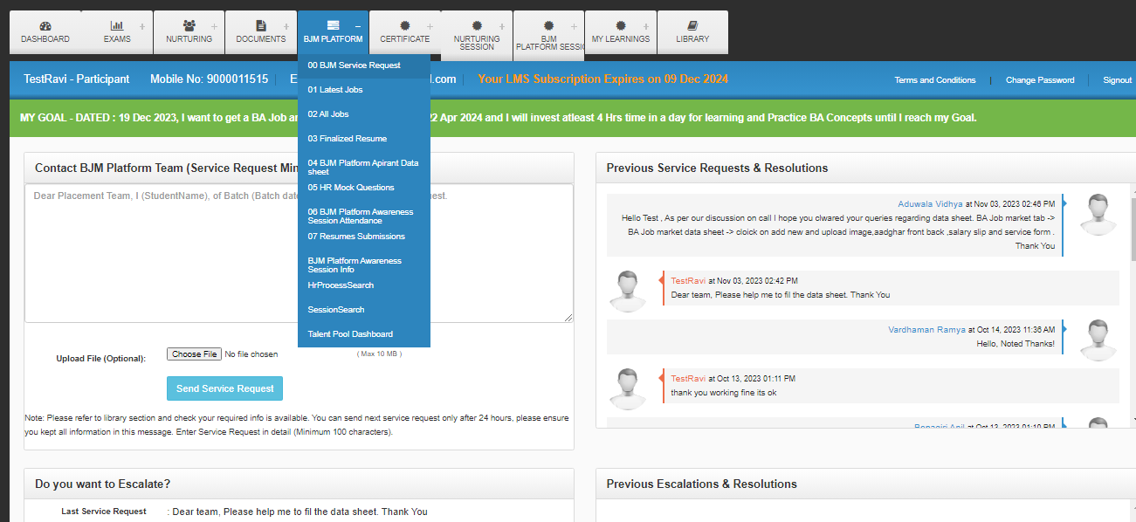
BA Job Market - Awareness Session
Valid till 31 Dec 2024
5. BJM Service Requests & Escalations
Utilize BJM Service Request feature in BJM Platform Tab, go to BJM service request to interact with Team HR - Talent Pool
Aspirant should communicate through service requests in coepd portal
There should be minimum of 100 characters in the service request.
You can escalate on the non responded BJM Service request after 32 hours. By clicking that escalation button
Escalation is available only for 3 days after the Job Search service request is raised
Min TAT is 24 hours to raise BJM Service Request
5. BJM Service Req & Escalation
Slide 1/2

Slide 21
BA Job Market - Awareness Session
Valid till 31 Dec 2024
Before raising request about the BJM Platform, students should be careful to include all relevant information like finetuning resume, when applying for jobs, make final adjustments to your CV
Attending BJM Platform Awareness Session is mandatory to start the Team HR - Talent Pool wing support, before they raise a service request ,For every two weeks the candidate attend the induction or else Team HR - Talent Pool supports stops.
Availability of Service Request Window
10 AM to 5 PM ONLY
After 5PM,it will be deemed as next day submission
Available on weekdays only.(Monday to Saturday)
Not Available on Sunday’s and festival Holidays
5.BJM-Service Req&Escalation
Slide 2/2

Slide 22
BA Job Market - Awareness Session
Valid till 31 Dec 2024
6.BJM Platform Remedial Work - Challenges
Aspirant should be open to accept remedial work from HR/Mentors in case of continuous
failures in interviews
Nominate the Aspirant for remedial work in case of continuous failures, Part of the remedial work may involve nurturing process from the start. From redoing all projects (or any other B.A. work given at the time) and participating in mock interviews(BA Mocks).
6. BJM - Remedial work-Challenges
Slide 1/2

Slide 23
BA Job Market - Awareness Session
Valid till 31 Dec 2024
7.BA Job Market (BJM) Platform-Guidelines
Every day student has apply min 3 companies so that Coepd can understand the progress in resume submissions and those details need to update in Coepd portal.
If student fails to apply in 3 companies daily according to their experience & domain, it assumes that he/she don’t have interest in BA Job.
Which implies to removal from the BJM Platform.
Attend all interviews, if called for, irrespective of your choices.
Companies will prefer direct applications from the candidates and the Companies will communicate directly with the Candidates
The Company will decide pay pack based on relevant experience not on overall experience
Shortlisting of the Aspirant’s resume is purely based on the respective Company’s Recruitment policy.
7.BJM-Platform Guidelines
Slide 1/2

Slide 24
BA Job Market - Awareness Session
Valid till 31 Dec 2024
7.BA Job Market (BJM) Platform-Guidelines -2
Don’t quit from present job, you can negotiate for more time to join next company.
Even companies will also ask the candidates to attend for face to face interviews
Facing interviews and justifying the candidature is Aspirant’s responsibility.
COEPD Services are valid till Subscription expiry date or until the first BA Job, whichever happens early.
COEPD Services Validity is displayed as LMS subscription expiry date in the student login of COEPD portal Refresh daily resume, location, skill sets in job portals.
Share your resume with friends and network circles (may be google groups, WhatsApp groups) and tell them you are looking for an opportunity.
7.BJM-Platform Guidelines
Slide 2/2

Slide 25
BA Job Market - Awareness Session
Valid till 31 Dec 2024
How Much Time It Will take – Job Search
Why It Delays……
Company Side
Aspirant Side
Company may take time to shortlist submitted Resumes(May be a week or Two or Month or Never)
Unable to Justify the profile BA experience
High Pay pack Expectations
Shortlisted Resume to call for interviews the company may take time
Location Constraints
Choosing Specific Companies Only
Company May take time to announce result of conducted interviews
Unable to give time for interviews or postponing scheduled interviews or not attending interviews

Slide 26
BA Job Market - Awareness Session
Valid till 31 Dec 2024
Success Tips
Maintain a Registry of your interviews in coepd student portal
Be clear about your Notice Period and Pay Pack Expectations
Daily allot 2 Hour time for interview preparation – revise your Resume n BA Knowledge
Make yourself available for the interviews – Schedule your interviews in your available time-slots
Think Positive – Not all interviews will be successful
Don’t blame others – Take responsibility of yourself and your Goal
Keep attending interviews until you are successful
Wish You All the Success !!!

